Slide 1

Computer Architecture and Logic Design (CALD)
Lecture 01

Slide 2
Recommended Books
Computer Architecture and Organization, Designing for Performance by William Stallings, 10th Edition.
Computer Organization and Design, by David Patterson and John Hennessy, 5th Edition.
Digital Logic & Computer Design by M. Morris Mano, latest Edition.

Slide 3
Basic Concepts of Computer Architecture

Slide 4
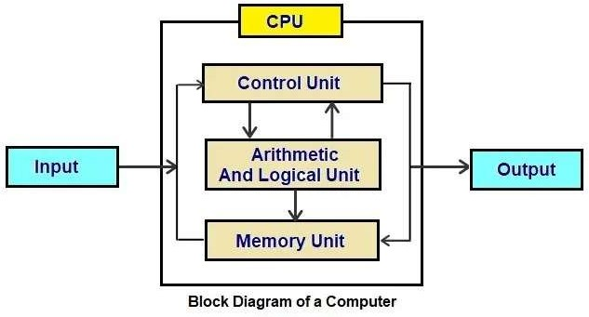
Block diagram of a Computer

Slide 5
Computer Architecture
Architecture refers to those attributes visible to the programmer or the attributes that have direct impact on the logical execution of a program.
  Instruction set
  Number of bits used for data representation
  I/O mechanisms
  Addressing techniques
Example: Architectural design issue - whether a computer will have a multiply instruction.

Slide 6
Computer Organization
Organization refers to the operational units and their interconnections that realize the architectural specifications.
Organizational attributes include those hardware detail transparent to the programmer.
  Control Signals
  Interfaces between the computer and peripherals
  Memory technology
Example: Organizational issue – is there a special multiply unit or is it done by repeated addition.

Slide 7
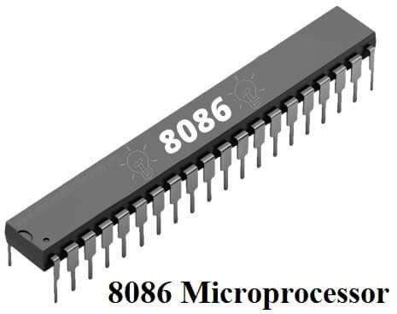
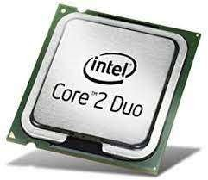
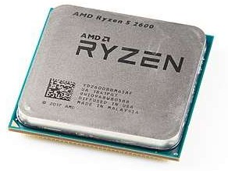
Architecture and Organization
Computer manufacturers offer a family of computer models all with same architecture but differences in organization.
Different models - different prices and performance characteristics.
Examples:
  All Intel x86 family share the same basic architecture
  The IBM System/370 family share the same basic architecture
This gives backward code compatibility.
Organization differs between different versions.

Slide 8
Structure and Function
Structure is the way in which components relate to each other
  How different components, like ALU, control, I/O, and memory are connected?
  How they interface with each other?
Function is the operation of individual components as part of the structure
  What is the function of a component?

Slide 9
Functions of a Computer
Data Processing
  Data may take a wide variety of forms
  Performing various operations on data
Data Storage
  Short and long term data storage
Data Movement
  Input-Output: Data is received from or delivered to a device that is directly connected to the computer. The device is referred to as a peripheral.
  Data Communications: Data is moved over longer distances, to or from a remote device.
Control
  A control unit manages the computer’s resources.

Slide 10
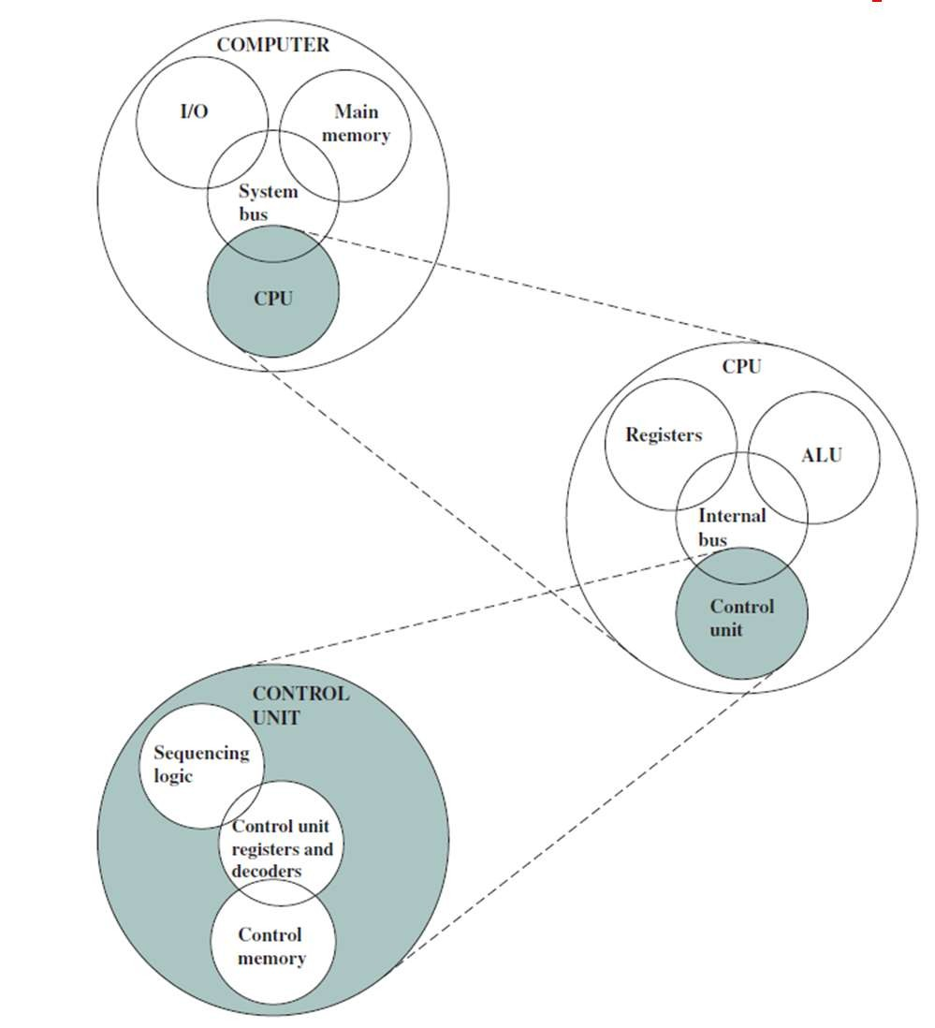
Top Level Structure of a Computer

Slide 11
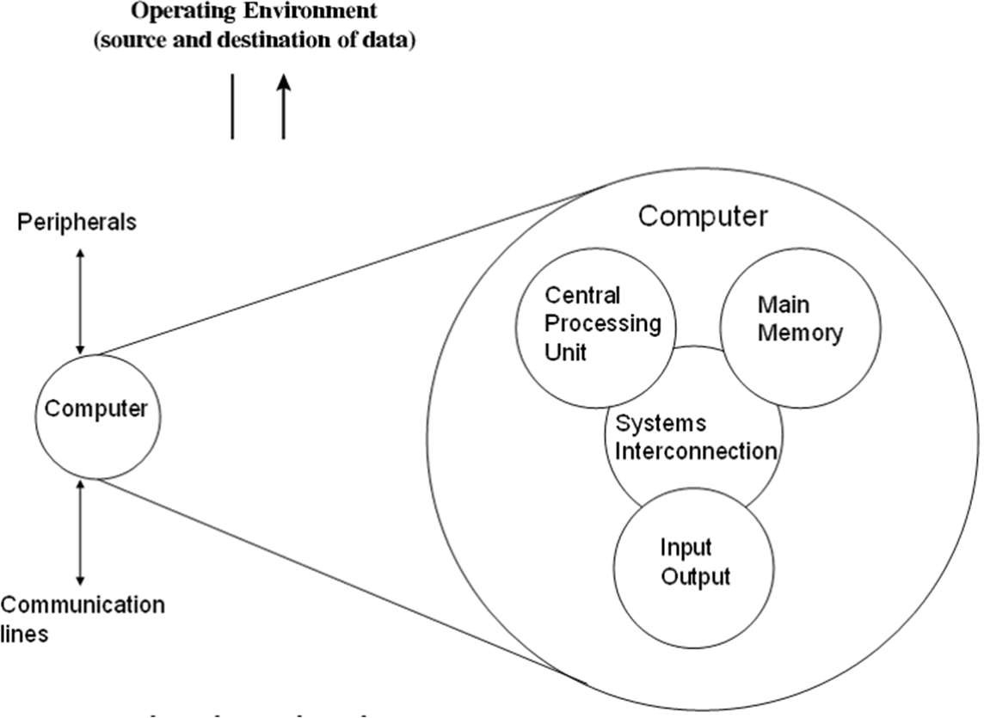
Structural Components: Computer
Central Processing Unit (CPU):
  Controls computer operations and performs data processing
Main Memory:
  Stores data
I/O:
  Data movement to and from computer and external environment
System Interconnection:
  Communication among CPU, main memory and I/O.

Slide 12
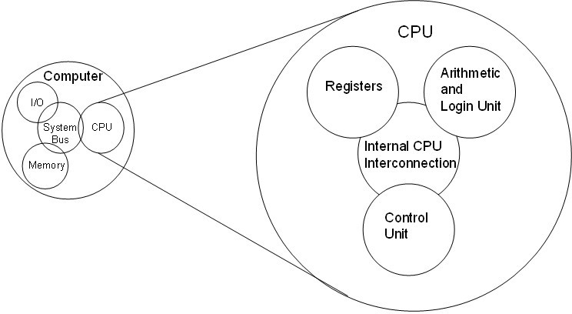
Structural Components: CPU
Control Unit:
  Controls the operations of a CPU.
Arithmetic and Logic Unit (ALU):
  Performs the computer’s data processing functions.
Registers:
  Provides internal storage to CPU.
CPU Interconnection:
  Communication among the control unit, ALU, and registers.

Slide 13
Multicore Computer Structure
Computers generally have multiple processors
Multicore computer – multiple processors reside on a single chip.
Each processing unit is called a core and it consists of a control unit, ALU, registers, and cache memory.

Slide 14
Multicore Computer Structure
Central Processing Unit (CPU):
  The portion of a computer that fetches and executes instructions.
  It consists of an ALU, a control unit and registers.
Core:
  An individual processing unit on a processor chip.
  Equivalent in functionality to a CPU on a single-CPU system.
Processor:
  A physical piece of silicon containing one or more cores.
  Interprets and executes instructions.
  If a processor contains multiple cores it is referred to as a multicore processor.

Slide 15
Cache Memory
Cache memory lies between the processor and main memory.
It is smaller and faster than main memory.
It is used to speed up memory access, by placing data from main memory into cache memory that is likely to be used in near future.
Multiple levels of cache (L1, L2, L3, ...) can be used to improve performance.
Level L1 is closest to the core and additional levels (L2, L3, and so on) are farther away from the core.
Level n is smaller and faster than level n+1.

Slide 16
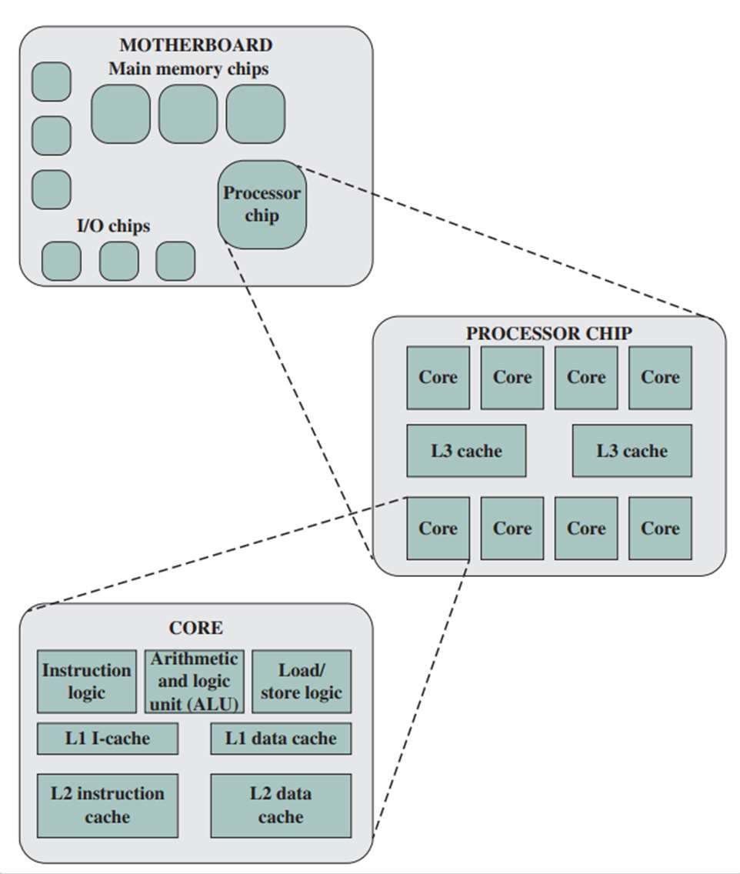
Elements of a Multicore Computer

Slide 17
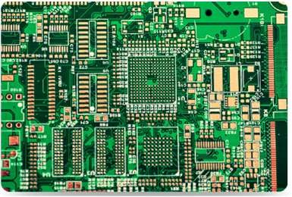
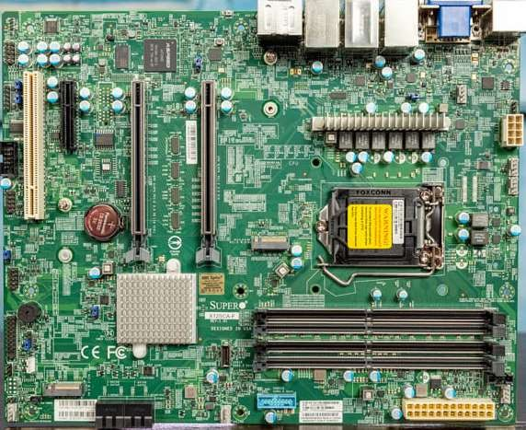
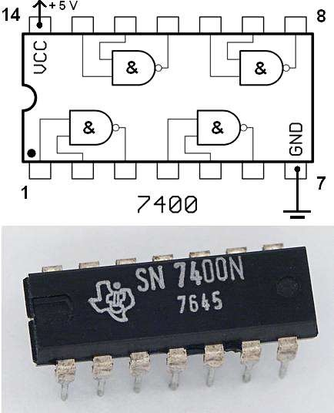
Elements of a Multicore Computer
Printed Circuit Board (PCB):
  A rigid, flat board that holds and interconnects chips and other electronic components.
Motherboard:
  Motherboard is the main printed circuit board (PCB) in a computer.
  It is also known as system board.
Chip:
  The most prominent elements on the motherboard are called chips.
  A chip is a single piece of semi-conducting material, typically silicon, upon which electronic circuits and logic gates are fabricated.
  The resulting product is referred to as an Integrated Circuit (IC).

Slide 18
Elements of a core
Instruction Logic:
  Fetching and decoding instructions.
  Determine instruction operations and memory locations of any operands.
Arithmetic and Logic Unit (ALU):
  Performs the operation specified by an instruction.
Load/Store Logic:
  Manages the transfer of data to and from main memory via cache.
Instruction Cache:
  Used for transfer of instructions to and from main memory.
Data Cache:
  Used for transfer of operands and results to and from main memory.

