Slide 1
Computer Architecture and Logic Design (CALD)
Lecture 06
+

Slide 2
Instruction Sets: Characteristics and Functions

Slide 3
Machine Instruction Characteristics
+
The operation of the processor is determined by the instructions it executes, referred to as machine instructions or computer instructions
The collection of different instructions that the processor can
execute is referred to as the processor’s instruction set
Each instruction must contain the information required by the processor for execution

Slide 4
Elements of a Machine Instruction
Operation code
(opcode)
Specifies the operation to be performed. The operation is specified by a binary code, known as the operation code, or opcode
Source operand
reference
The operation may involve one or more source operands, that is, operands that are inputs for the operation
Result operand reference
The operation may
produce a result
Next instruction reference
This tells the processor where to fetch the next instruction after the execution of this instruction is complete

Slide 5
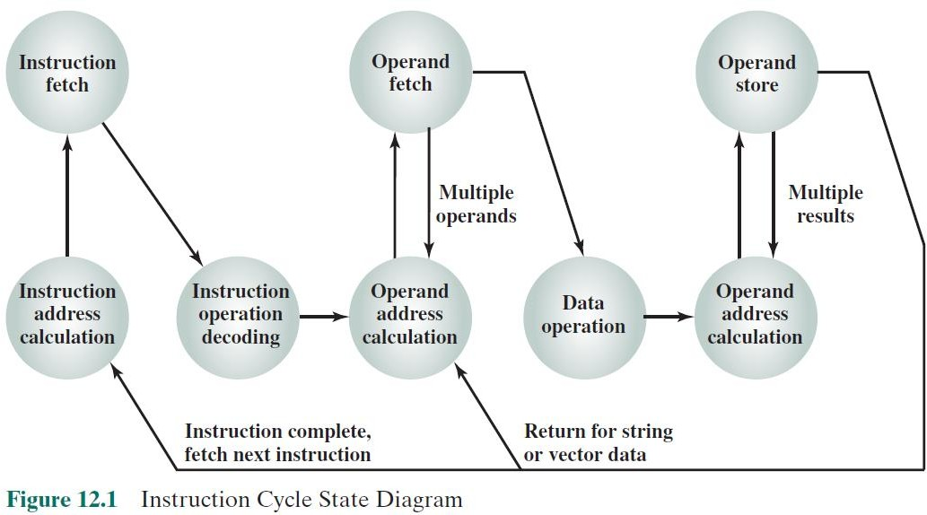
⁺ Instruction Cycle State Diagram

Slide 6
Source and result operands can be in one of four areas:
Processor register
A processor contains one or more registers that may be referenced by machine instructions.
If more than one register exists each register is assigned a unique name or number and the instruction must contain the number of the desired register
Immediate
The value of the operand is contained in a field in the instruction being executed
Main or virtual memory
As with next instruction references, the main or virtual memory address must be supplied
I/O device
The instruction must specify the I/O module and device for the operation. If memory- mapped I/O is used, this is just another main or virtual memory address

Slide 7
⁺ Instruction Representation
Within the computer each instruction is represented by a sequence of bits
The instruction is divided into fields, corresponding to the constituent elements of the instruction
4 bits 6 bits 6 bits
Opcode | Operand Reference | Operand Reference
16 bits
Figure 10.2 A Simple Instruction Format
Figure 12.2 A Simple Instruction Format

Slide 8
⁺ Instruction Representation
Opcodes are represented by abbreviations called mnemonics
Examples include:
ADD
SUB
MUL
DIV
LOAD
STOR
Add Subtract Multiply Divide
Load data from memory
Store data to memory
Operands are also represented symbolically
Each symbolic opcode has a fixed binary representation
The programmer specifies the location of each symbolic operand

Slide 9
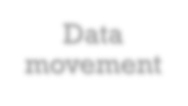
Instruction Types
Arithmetic instructions provide computational capabilities for processing numeric data
Logic (Boolean) instructions operate on the bits of a word as bits rather than as numbers, thus they provide capabilities for processing any other type of data the user may wish to employ
Movement of data into or out of register and or memory locations
Data processing
Data storage
Data
movement
Control
Test instructions are used to test the value of a data word or the status of a computation
Branch instructions are used to branch to a different set of instructions depending on the decision made
I/O instructions are needed to transfer programs and data into memory and the results of computations back out to the user

Slide 10
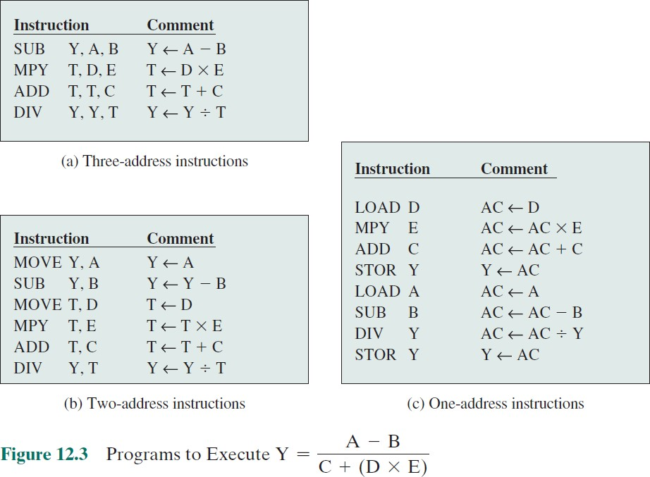

Slide 11
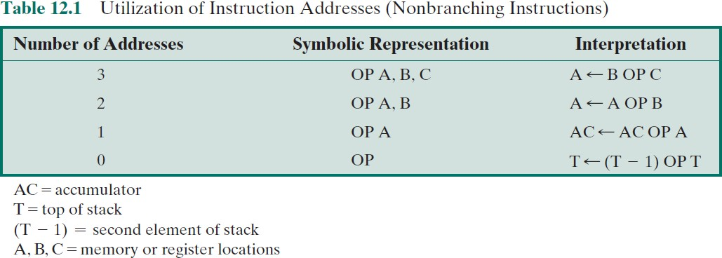

Slide 12
⁺ Number of Addresses
3 addresses
Operand 1, Operand 2, Result
a = b + c;
May be a forth - next instruction (usually implicit)
Not common scheme
Needs very long words to hold everything

Slide 13
⁺ Number of Addresses
2 addresses
One address doubles as operand and result
a = a + b
Reduces length of instruction
Common format in most architectures
Requires some extra work
Temporary storage to hold some results

Slide 14
⁺ Number of Addresses
1 address
Implicit second address
Usually a register (accumulator)
Common on early machines

Slide 15
⁺ Number of Addresses
0 (zero) addresses
All addresses implicit
Uses a stack
e.g. push a
push b
add
pop c
c = a + b

Slide 16
⁺ Instruction Addresses
The number of addresses per instruction is a basic design
decision.
Fewer addresses per instruction:
less complex processor.
instructions of shorter length.
programs contain more total instructions
results in longer execution times and
longer, more complex programs.

Slide 17
⁺ Instruction Addresses
Also, there is an important threshold between one-address and
multiple-address instructions.
With one-address instructions, the programmer generally has available only one general-purpose register, the accumulator.
With multiple-address instructions, it is common to have multiple general-purpose registers.
This allows some operations to be performed solely on registers.
Because register references are faster than memory references,
this speeds up execution.
For reasons of flexibility and ability to use multiple registers, most contemporary machines employ a mixture of two- and three-address instructions.

Slide 18
Instruction Set Design
Very complex because it affects so many aspects of the computer system
Defines many of the functions performed by the processor
Programmer’s means of controlling the processor
Fundamental design issues:
Operation repertoire How many and which operations to provide and how complex operations should be | Data types The various types of data upon which operations are performed | Instruction format Instruction length in bits, number of addresses, size of various fields, etc. | Registers Number of processor registers that can be referenced by instructions and their use | Addressing The mode or modes by which the address of an operand is specified

Slide 19
⁺ Fundamental Design Issues
Operation repertoire
How many and which operations to provide, and how complex operations should be
Data types
The various types of data upon which operations are performed
Instruction format
Instruction length (in bits), number of addresses, size of various fields, and so on
Registers
Number of processor registers that can be referenced by instructions,
and their use
Addressing
The mode or modes by which the address of an operand is specified

Slide 20
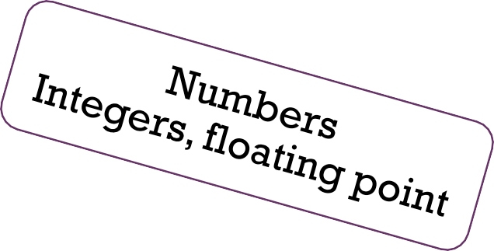
Types of Operands

Slide 21
⁺ Types of Operations
Data transfer
Arithmetic
Logical
Conversion
I/O
System control
Transfer of control

Slide 22
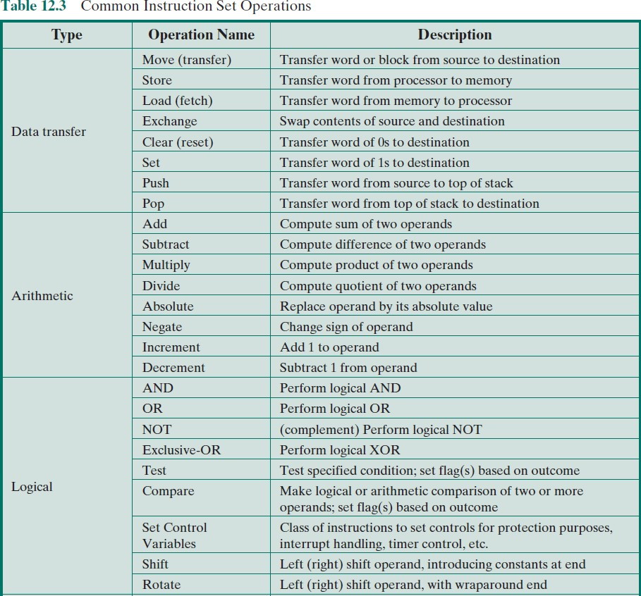

Slide 23
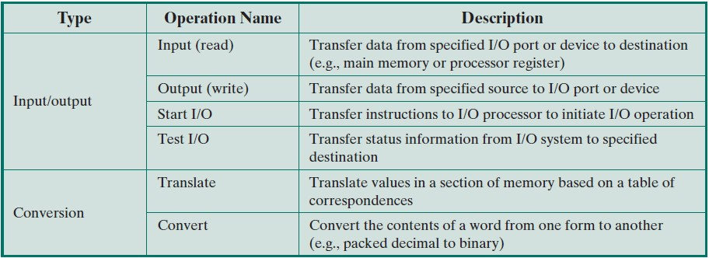
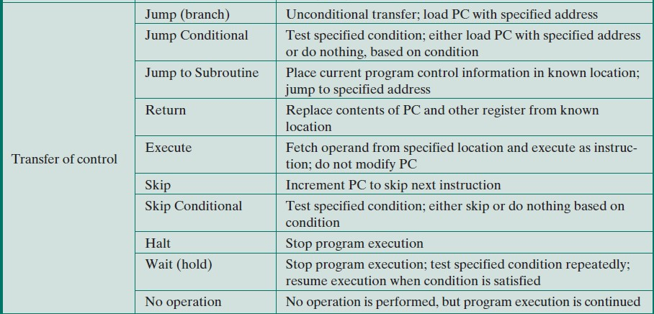

Slide 24
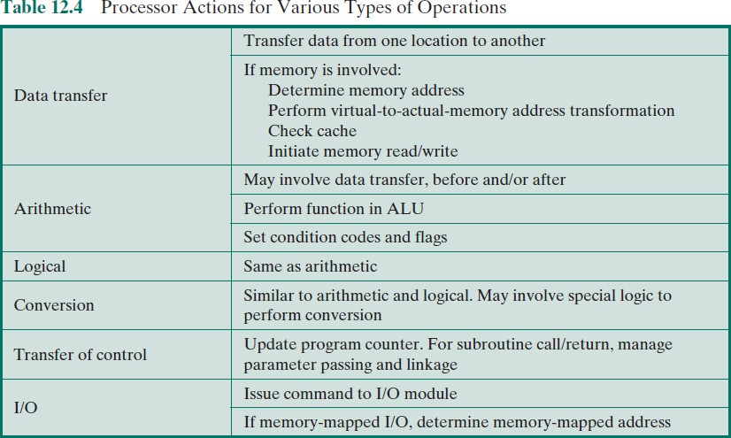
⁺ Processor Actions

Slide 25
Data Transfer
Must specify:
Location of the source and destination operands
The length of data to be transferred must be indicated
The mode of addressing for each operand must be specified
Most fundamental type of machine instruction

Slide 26
Arithmetic
+
Add, Subtract, Multiply, Divide
Signed Integer
Floating point ?
May include
Increment (a++)
Decrement (a--)
Negate (-a)

Slide 27
⁺ Logical

Slide 28
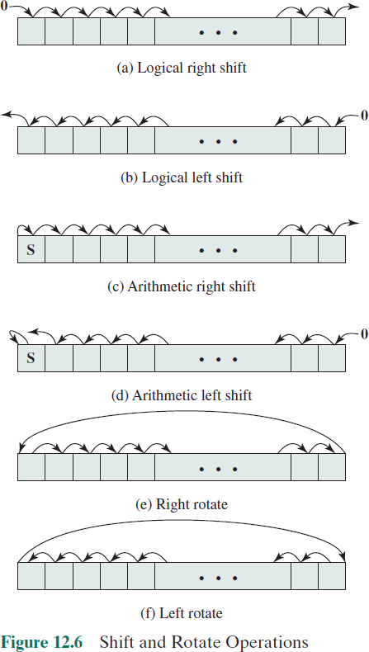

Slide 29
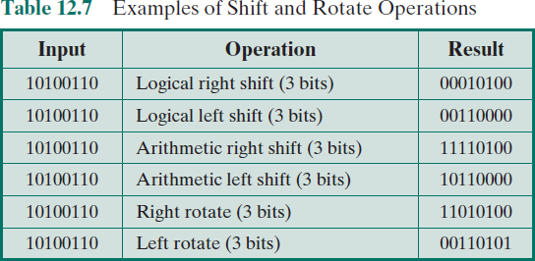
⁺ Logical

Slide 30
Instructions that change the format or operate on the format of data
Conversion
An example of a more complex editing instruction is the EAS/390
Translate (TR) instruction
An example is converting from decimal to binary

Slide 31
Input/Output
+
Variety of approaches taken:
Isolated programmed I/O
Memory-mapped programmed I/O
DMA
Use of an I/O processor
Many implementations provide only a few I/O instructions, with the specific actions specified by parameters, codes, or command words

Slide 32
System Control
Instructions that can be executed only while the processor is in a certain privileged state or is executing a program in a special privileged area of memory
Typically these instructions are reserved for the use of the operating system
Examples of system control operations:
A system control instruction may read or alter a control register
An instruction to read or modify a storage protection key
Access to process control blocks in a multiprogramming system

Slide 33
⁺ Transfer of Control
Reasons why transfer-of-control operations are required:
It is essential to be able to execute each instruction more than
once
Virtually all programs involve some decision making
It helps if there are mechanisms for breaking the task up into smaller pieces that can be worked on one at a time
Most common transfer-of-control operations found in instruction sets:
Branch
Skip
Procedure call

Slide 34
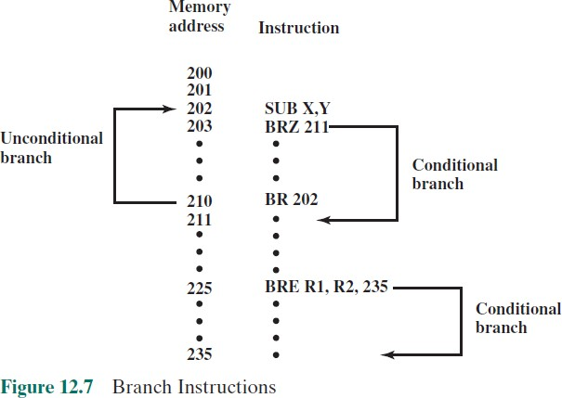
+
Transfer of Control (Branch Instructions)

Slide 35
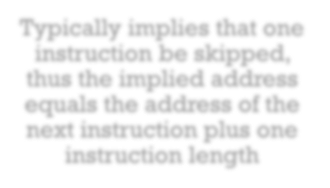
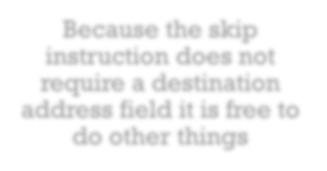
Transfer of Control (Skip Instructions)
Includes an implied address
Typically implies that one instruction be skipped, thus the implied address equals the address of the next instruction plus one instruction length
Example is the increment-and-skip-if- zero (ISZ) instruction
Because the skip instruction does not require a destination address field it is free to do other things

Slide 36
⁺ Transfer of Control (Procedure Call Instructions)
Self-contained computer program that is incorporated into a
larger program
At any point in the program the procedure may be invoked, or called
Processor is instructed to go and execute the entire procedure and then return to the point from which the call took place
Two principal reasons for use of procedures:
Economy
A procedure allows the same piece of code to be used many times
Modularity
Involves two basic instructions:
A call instruction that branches from the present location to the
procedure
Return instruction that returns from the procedure to the place from which it was called

Slide 37
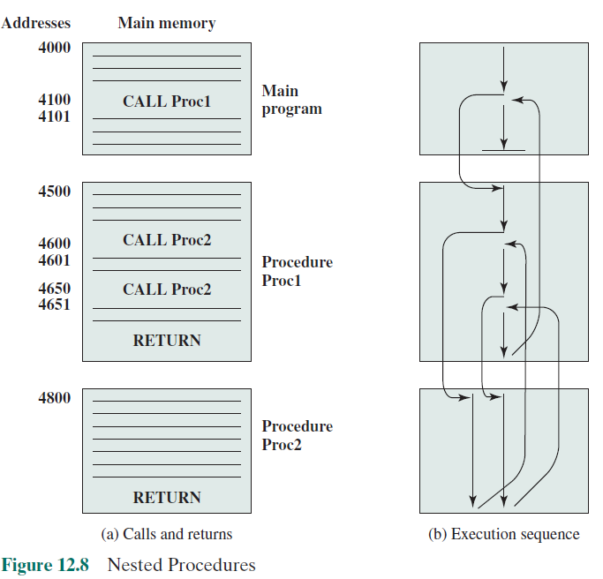

Slide 38
⁺ Transfer of Control (Procedure Call Instructions)

Slide 39
ARM Operation Types
Load and store instructions
Branch instructions
Data-processing instructions
Multiply instructions
Extend instructions
Parallel addition and subtraction instructions
Status register access instructions

Slide 40
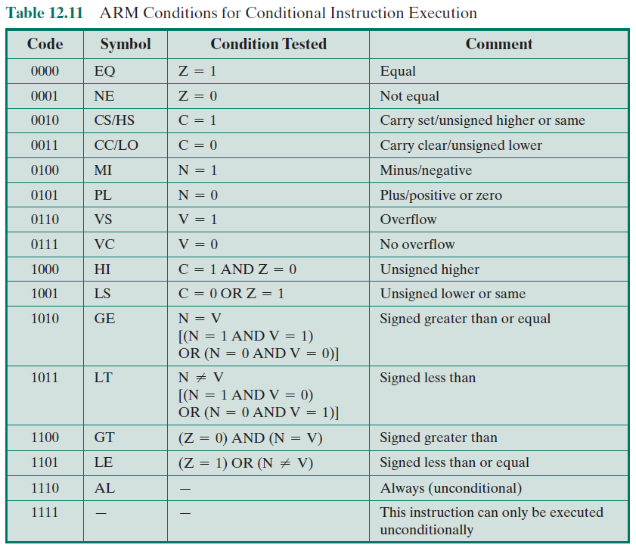

Slide 41
Summary
+
Instruction Sets: Characteristics and Functions
Chapter 12
Machine instruction characteristics
Elements of a machine instruction
Instruction representation
Instruction types
Number of addresses
Instruction set design
Types of operands
Numbers
Characters
Logical data
Types of operations
Data transfer
Arithmetic
Logical
Conversion
Input/output
System control
Transfer of control
ARM operation types

