Slide 1
Lecture 21
Finite-State Automata

Slide 2
Finite-State Automaton
A finite-state machine or finite-state automaton , finite automaton or simply a state machine, is a mathematical model of computation.
It is an abstract machine that can be in exactly one of a finite number of states at any given time.
The FSM can change from one state to another in response to some external inputs; the change from one state to another is called a transition.
An FSM is defined by a list of its states, its initial state, and the conditions for each transition.

Slide 3
Finite-State Automaton
Each piece of input to a finite-state automaton (aw-TAHM-uh-tahn) leads to a change in the state of the automaton, which in turn affects how subsequent input is processed.
One of the most important applications of finite-state machines is in Language Recognition.
This application plays a fundamental role in the design and construction of compilers for programming languages.

Slide 4
Finite-State Automata
Examples are
Vending machines, which dispense products when the proper combination of coins is deposited,
Elevators, whose sequence of stops is determined by the floors requested by riders, traffic lights,

Slide 5
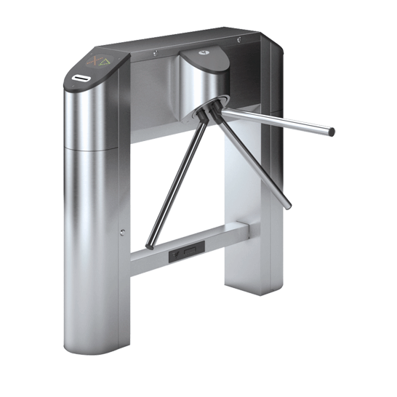
Finite state machine
An example of a simple mechanism that can be modeled by a state machine is a turnstile.
A turnstile, used to control access to subways and amusement park rides, is a gate with three rotating arms at waist height, one across the entryway.
Initially the arms are locked, blocking the entry, preventing patrons from passing through.
Depositing a coin or token in a slot on the turnstile unlocks the arms, allowing a single customer to push through.
After the customer passes through, the arms are locked again until another coin is inserted.

Slide 6
Finite state machine
Considered as a state machine, the turnstile has two possible states: Locked and Unlocked.
There are two possible inputs that affect its state: putting a coin in the slot (coin) and pushing the arm (push).
In the locked state, pushing on the arm has no effect; no matter how many times the input push is given, it stays in the locked state.
Putting a coin in – that is, giving the machine a coin input – shifts the state from Locked to Unlocked.
In the unlocked state, putting additional coins in has no effect; that is, giving additional coin inputs does not change the state. However, a customer pushing through the arms, giving a push input, shifts the state back to Locked.

Slide 7
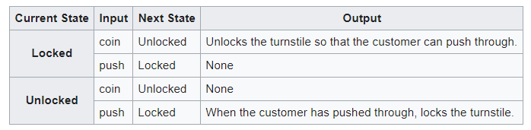
Finite state machine
The turnstile state machine can be represented by a state transition table, showing for each possible state, the transitions between them (based upon the inputs given to the machine) and the outputs resulting from each input:

Slide 8
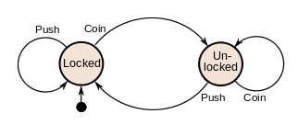
Finite state machine
The turnstile state machine can also be represented by a directed graph called a state diagram.
Each state is represented by a node (circle).
Edges (arrows) show the transitions from one state to another.
Each arrow is labeled with the input that triggers that transition.
An input that doesn't cause a change of state (such as a coin input in the Unlocked state) is represented by a circular arrow returning to the original state.
The arrow into the Locked node from the black dot indicates it is the initial state.

Slide 9
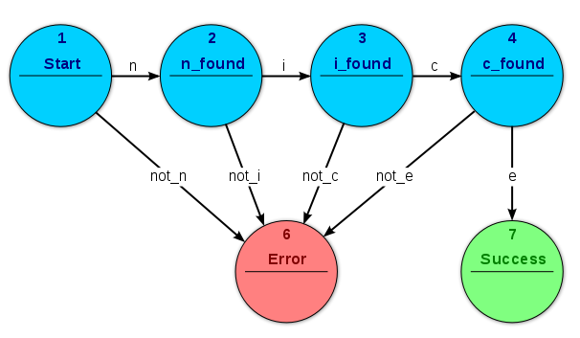
Finite state machine
The example shows a finite state machine that accepts the string "nice". In this FSM, the only accepting state is state 7.

Slide 10
A Simple Vending Machine
The machine dispenses piece of candy that cost 20 cent each.
Only two types of coins can be used
– 10c coins and 5c coins.
The machine does not return any change

Slide 11
A Simple Vending Machine
5 cents
Deposit 10c
15 cents
Each circle represents a state of the machine:
the state in which
0 cent,5 cents, 10 cents or 15 cents has been deposited.
Deposit 5c
Deposit 5c
Deposit 5c
0 cent
Deposit 10c
Deposit 5c
Deposit 5c
Deposit 10c
The unlabeled arrow pointing to “0 cent” indicates that this is the initial state of the machine.
Deposit 10c
20 cents
or more
10 cents
Deposit 10c
The arrows that link the states indicate what happens when a particular input is made to the machine in each of its various states.
For instance, the arrow labeled “deposit 5” that goes from “0c/” to “5c/” indicates that when the machine is in the state “0c/” and 5c/ is inserted, the machine goes to the state “5c/”
The double circle around “20 cents or more” indicates that a piece of candy is released when the machine has reached this state. (It is called an accepting state of the machine because when the machine is in this state, it has accepted the input sequence of coins as payment for candy.)

Slide 12
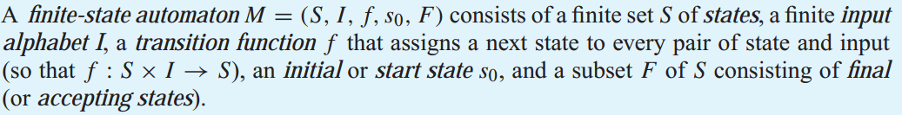
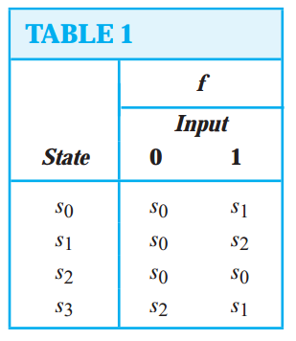
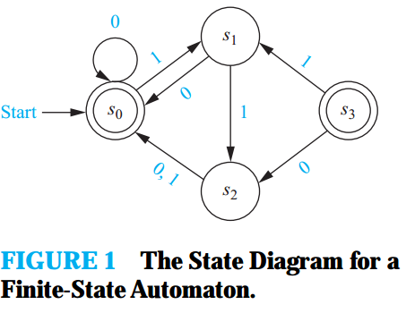
Finite-State Machines with No Output

Slide 13
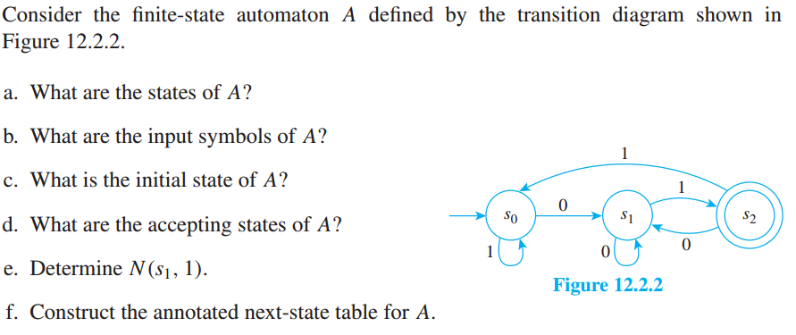
A Finite-State Automaton Given by a Transition Diagram

Slide 14
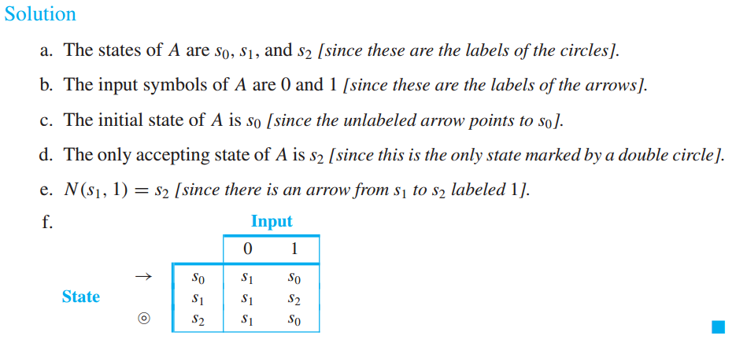
A Finite-State Automaton Given by a Transition Diagram

Slide 15
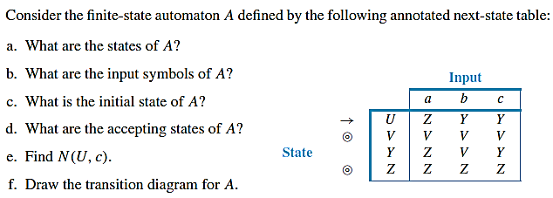
Example

Slide 16
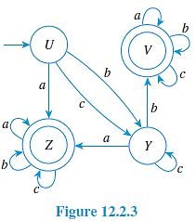
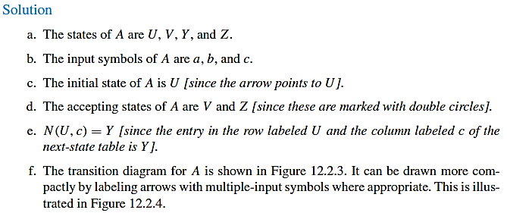
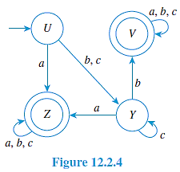
Example

Slide 17
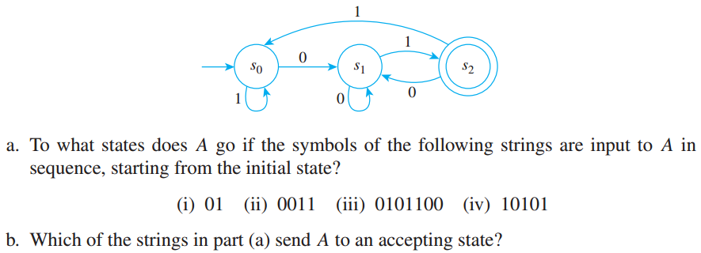
Finding the Language Accepted by an Automaton
Consider the finite-state automaton A shown below

Slide 18
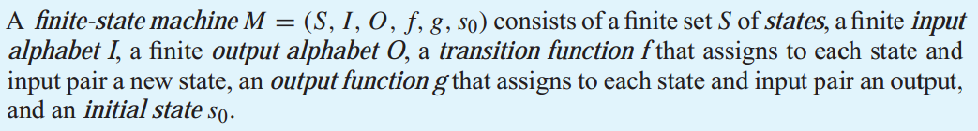
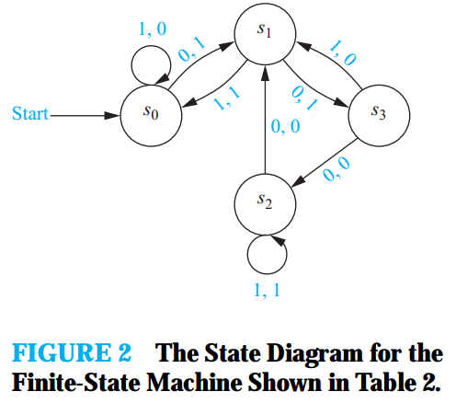
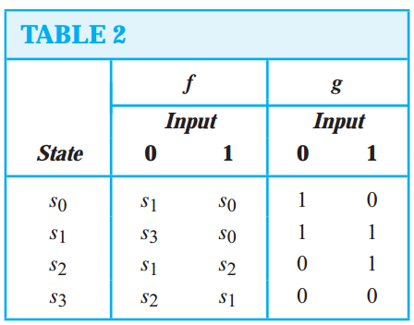
Finite-State Machines with Outputs

Slide 19
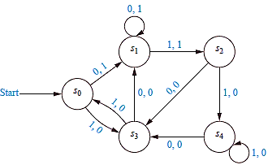
Example
Construct the state table for the finite-state machine with the state diagram shown in Figure.

Slide 20
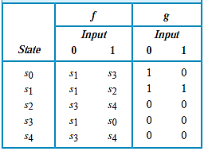
Example 2
Construct the state table for the finite-state machine with the state diagram shown in Figure.

Slide 21
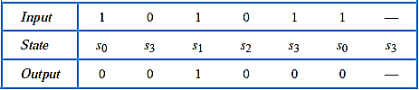
Example 3
Find the output string generated by the finite-state machine in last example if the input string is 101011.
The output obtained is 001000. The successive states and outputs are shown in Table:

Slide 22
REFERENCES
Kenneth Rosen Discrete Mathematics and Its Applications – Chapter # 13
Discrete Mathematics with Applications by Susanna (4e)– Chapter # 12

