Slide 1
MERGE SORT AND QUICK SORT

Slide 2
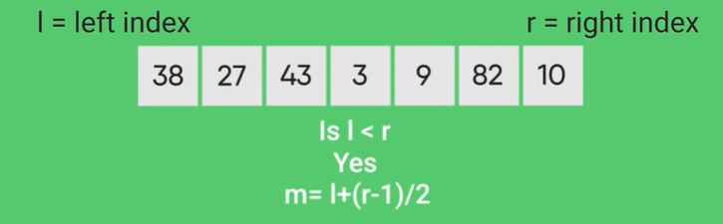
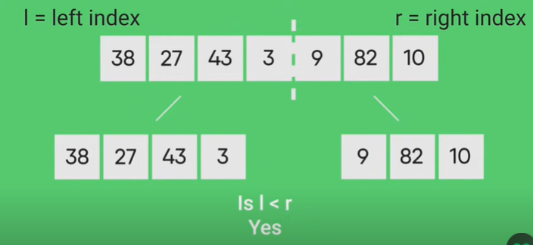
MERGE SORT

Slide 3
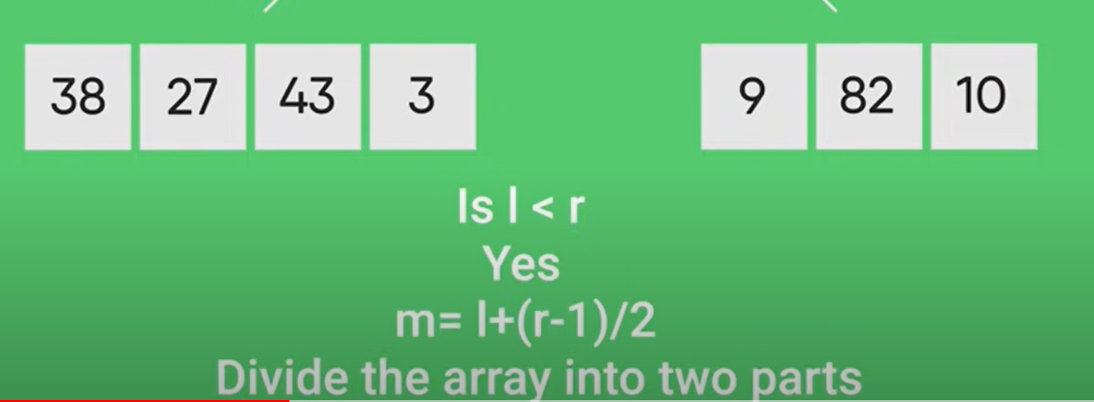
MERGE SORT

Slide 4
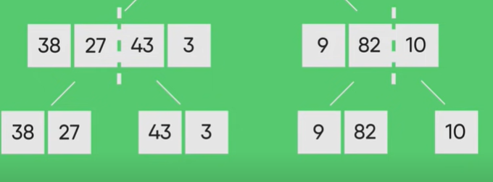
MERGE SORT

Slide 5
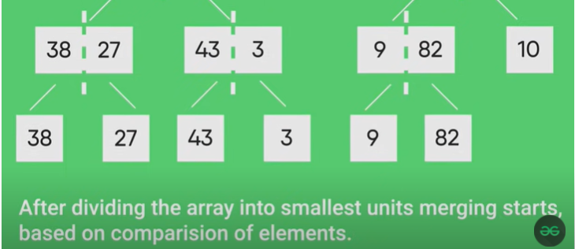
MERGE SORT

Slide 6
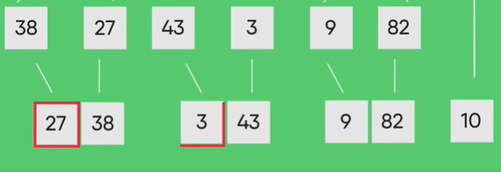
MERGE SORT

Slide 7
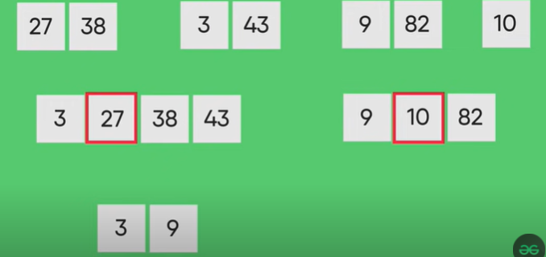
MERGE SORT

Slide 8
MERGE SORT

Slide 9
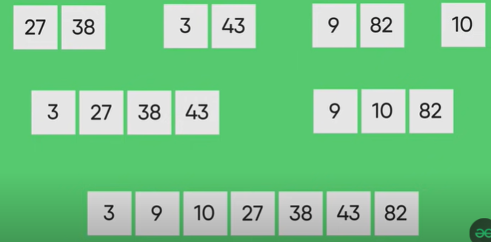
MERGE SORT

Slide 10
MERGE SORT
/ Merge the temp arrays
// Initial indexes of first
// and second subarrays
i = 0;
j = 0;
// Initial index of merged
// subarray array
int k = l;
while (i < n1 && j < n2) {
if (L[i] <= R[j]) {
arr[k] = L[i];
i++;
}
else {
arr[k] = R[j];
j++;
}
k++;
}
// Copy remaining elements
// of L[] if any
while (i < n1) {
arr[k] = L[i];
i++;
k++;
}
// Copy remaining elements
// of R[] if any
while (j < n2) {
arr[k] = R[j];
j++;
k++;
}
}
System;
class MergeSort {
// Merges two subarrays of []arr.
// First subarray is arr[l..m]
// Second subarray is arr[m+1..r]
void merge(int[] arr, int l, int m, int r)
{
// Find sizes of two
// subarrays to be merged
int n1 = m - l + 1;
int n2 = r - m;
// Create temp arrays
int[] L = new int[n1];
int[] R = new int[n2];
int i, j;
// Copy data to temp arrays
for (i = 0; i < n1; ++i)
L[i] = arr[l + i];
for (j = 0; j < n2; ++j)
R[j] = arr[m + 1 + j];

Slide 11
MERGE SORT
// Main function that
// sorts arr[l..r] using
// merge()
void sort(int[] arr, int l, int r)
{
if (l < r) {
// Find the middle
// point
int m = l+ (r-l)/2;
// Sort first and
// second halves
sort(arr, l, m);
sort(arr, m + 1, r);
// Merge the sorted halves
merge(arr, l, m, r);
}
}
static void printArray(int[] arr)
{
int n = arr.Length;
for (int i = 0; i < n; ++i)
Console.Write(arr[i] + " ");
Console.WriteLine();
}

Slide 12
MERGE SORT
public static void Main(String[] args)
{
int[] arr = { 12, 11, 13, 5, 6, 7 };
Console.WriteLine("Given Array");
printArray(arr);
MergeSort ob = new MergeSort();
ob.sort(arr, 0, arr.Length - 1);
Console.WriteLine("\nSorted array");
printArray(arr);
}

Slide 13
MERGE SORT TASKS
Implement recursive method of merge sort algorithm to sort an array of 10 characters.

Slide 14
Quick Sort
Lab No. 6
ENGR. SANIYA SHAIKH

Slide 15
QUICKSORT
Like Merge Sort, QuickSort is a Divide and Conquer algorithm. It picks an element as pivot and partitions the given array around the picked pivot. There are many different versions of quickSort that pick pivot in different ways.
Always pick first element as pivot.
Always pick last element as pivot (implemented below)
Pick a random element as pivot.
Pick median as pivot.

Slide 16
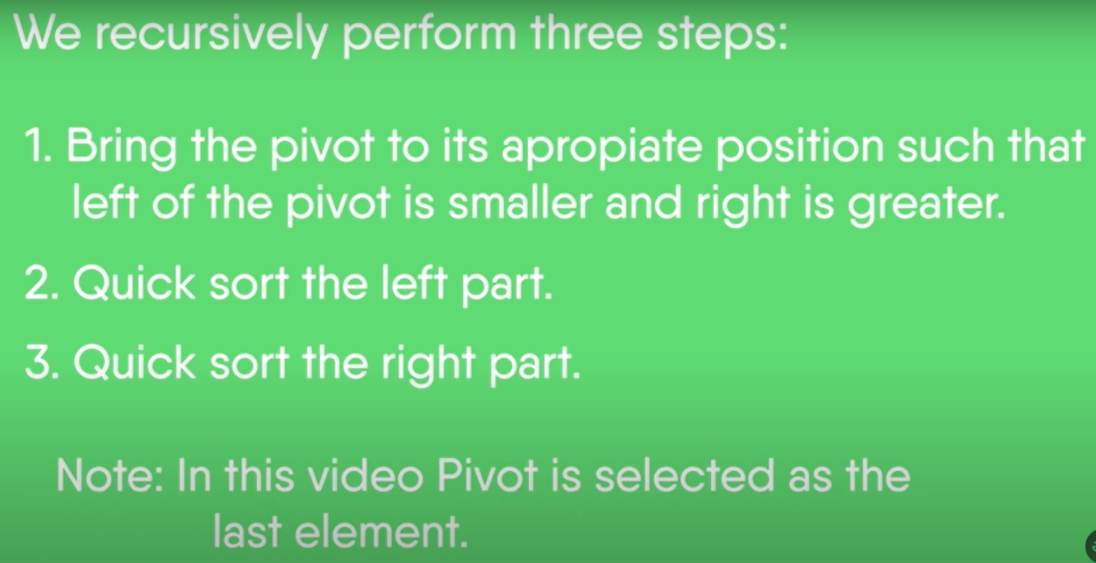
QUICK SORT

Slide 17
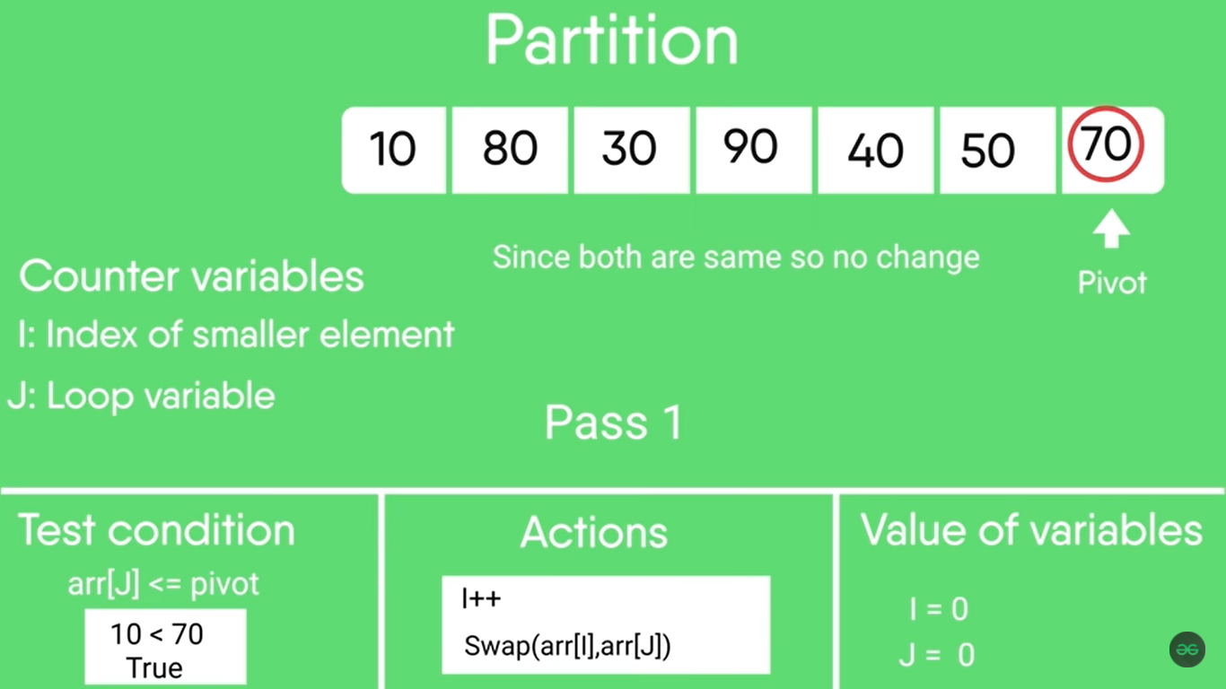
QUICK SORT

Slide 18
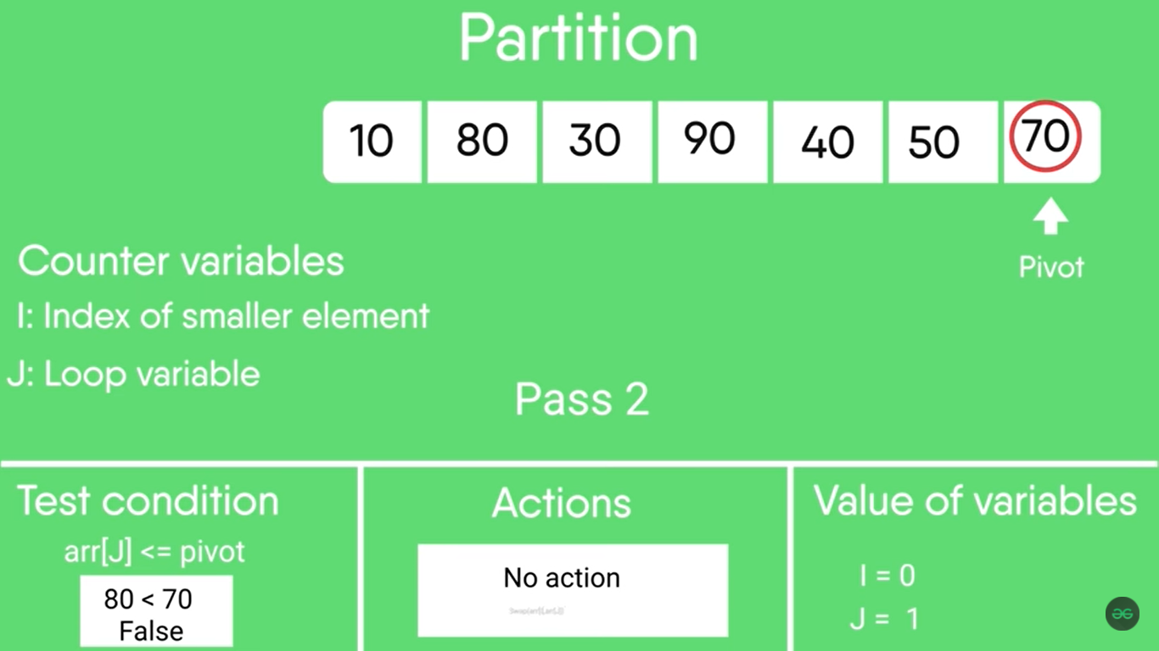
QUICK SORT

Slide 19
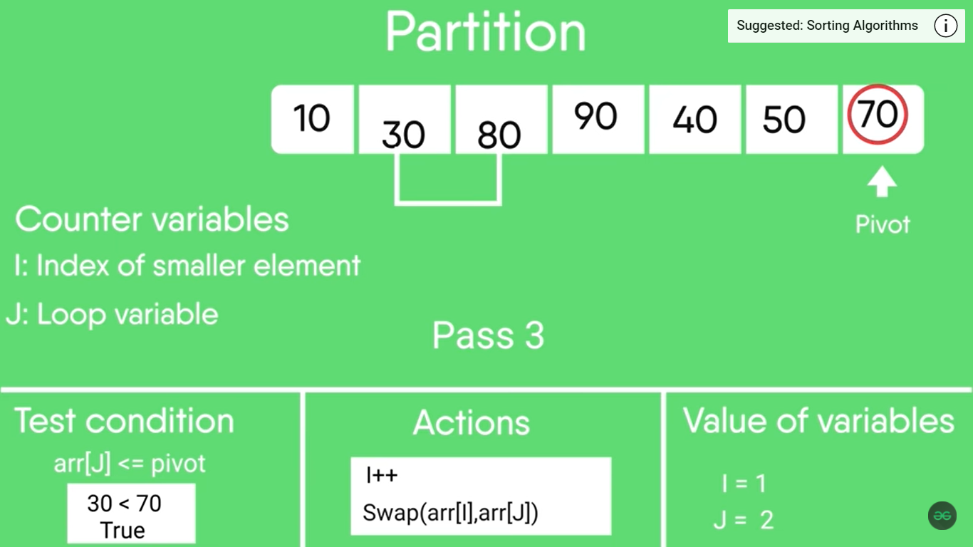
QUICK SORT

Slide 20

QUICK SORT

Slide 21

QUICK SORT

Slide 22
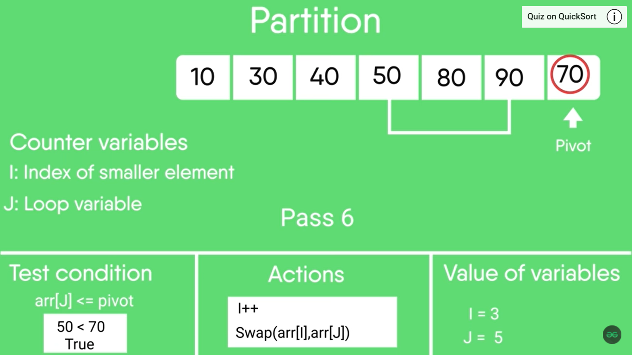
QUICK SORT

Slide 23
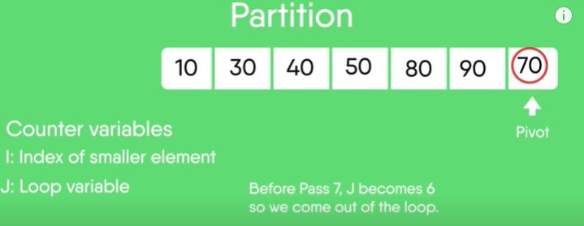
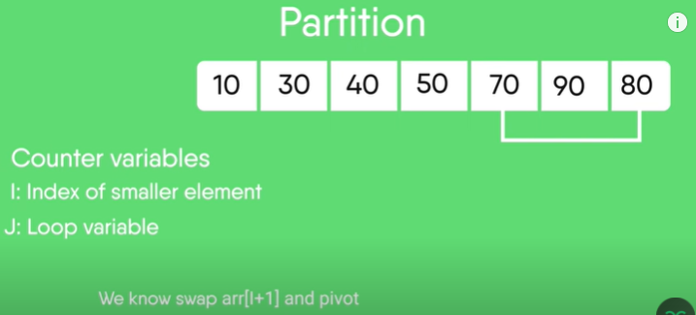
I=3

Slide 24
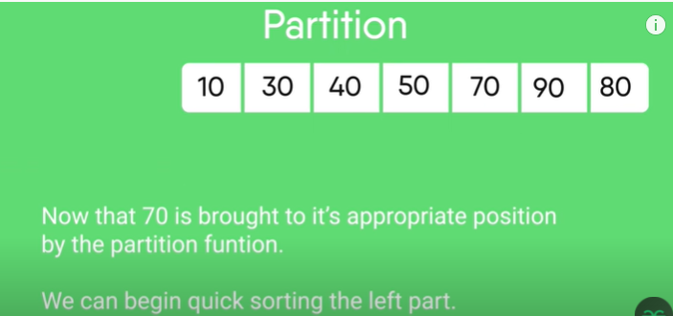

Slide 25
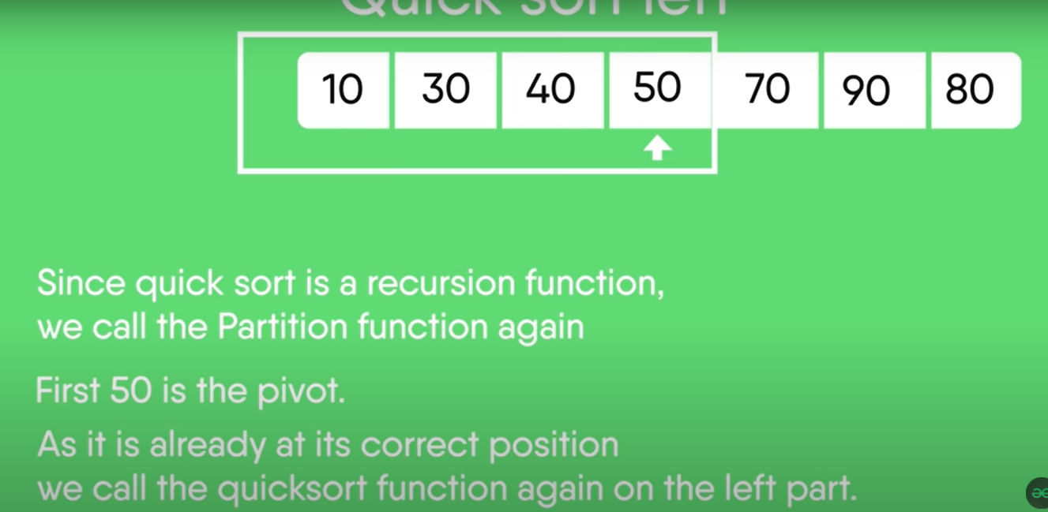

Slide 26
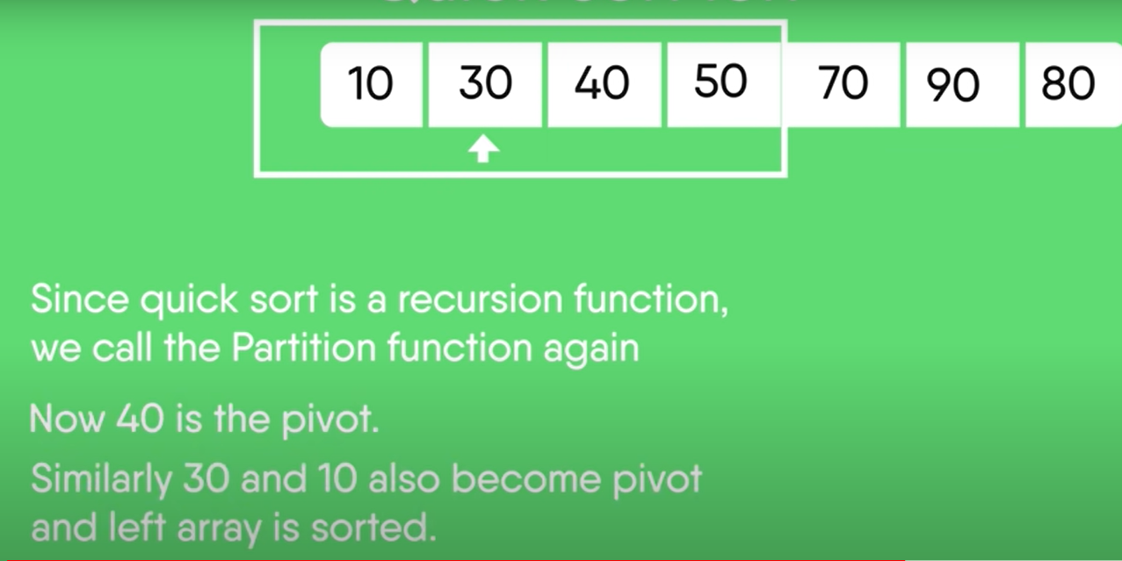

Slide 27
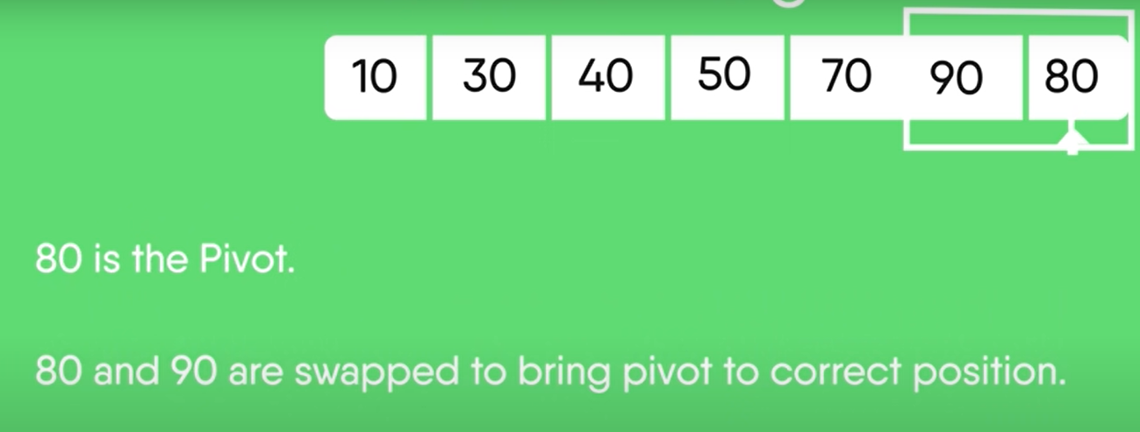

Slide 28
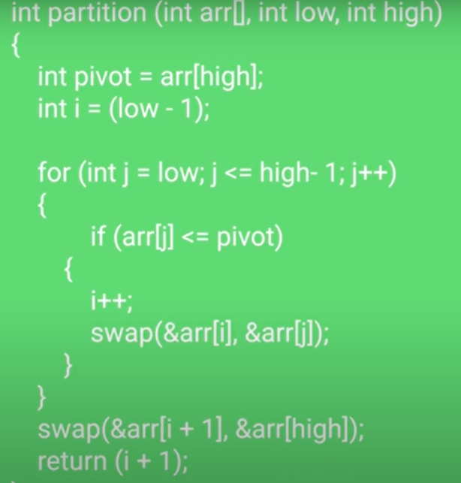
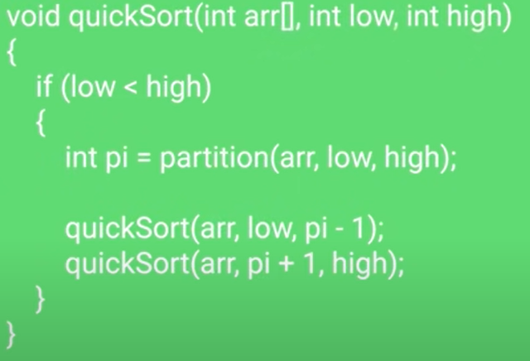

Slide 29
Quick Sort
The key process in quickSort is partition(). Target of partitions is, given an array and an element x of array as pivot, put x at its correct position in sorted array and put all smaller elements (smaller than x) before x, and put all greater elements (greater than x) after x. All this should be done in linear time

Slide 30
Lab Tasks
Implement Quick Sort Algorithm on string array using left value as Implement Quick Sort Algorithm on string array using left value as first pivoting value.
first pivoting value.
Implement Quick Sort Algorithm and design Windows Form Application in which you have to sort user input values in ascending and descending order as user requires, take right value as first pivoting value and show all the pivot values in a sequence they are selected.

