Slide 1
CSC-110 Computing FUNDAMENTALS FUNDAMENTALS OF DATABASE

Slide 2
What is a database?
Databases are everywhere, but you never see them.
They are hidden behind the tools and services that you use everyday.
Ever wondered where facebook, and twitter put their data?
It’s all stored in the database.

Slide 3
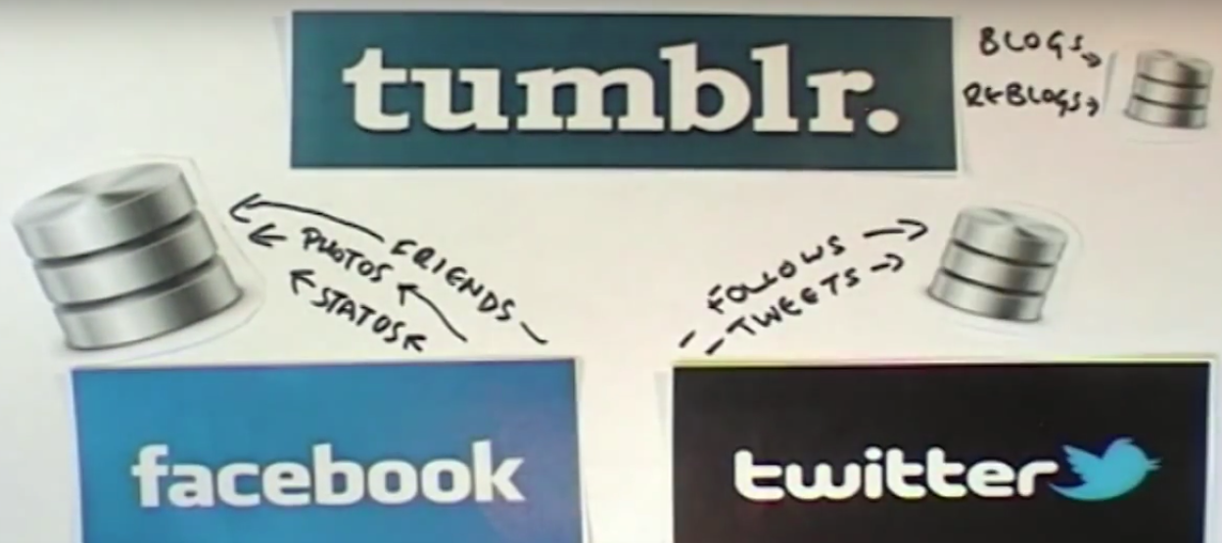

Slide 4
What is a database?
Where do google store it’s pages?
Where are the contacts in your mobile phone stored?

Slide 5
What is a database?
Databases do most of the work and the information systems that we use every day.
So what is a database? Is it just a random collection of stuff all squeezed in together.
No, databases are organized. Databases have a structure and all the data we store in them fits into this structure.

Slide 6
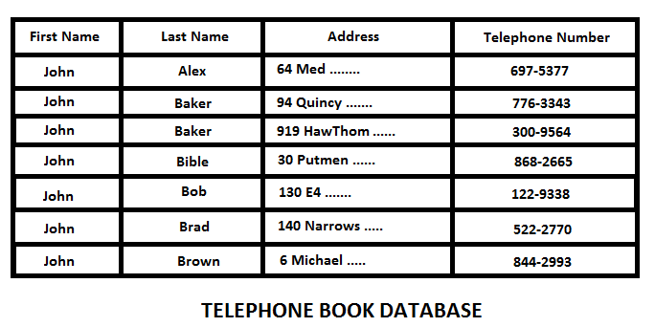
What is a database?

Slide 7
What is a database?
Simple type of databases are called flat-file databases.
They store data in columns of fields and rows called records.
What is a Record?
A complete set of information.
Records are composed of fields.
What is a field?
A space allocated for a particular item or information.
A collection of fields is called a record.

Slide 8
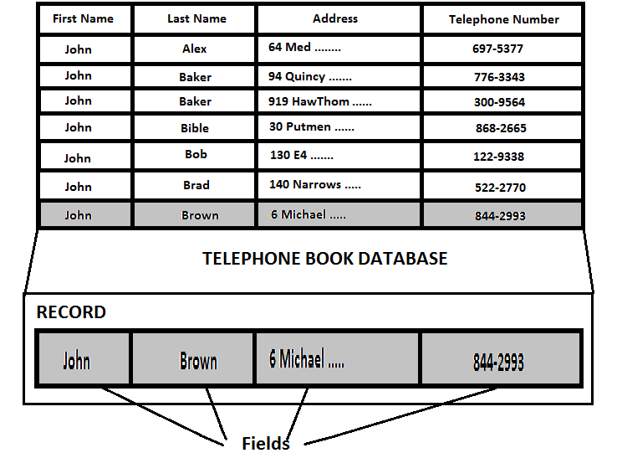

Slide 9
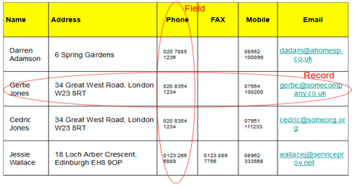

Slide 10
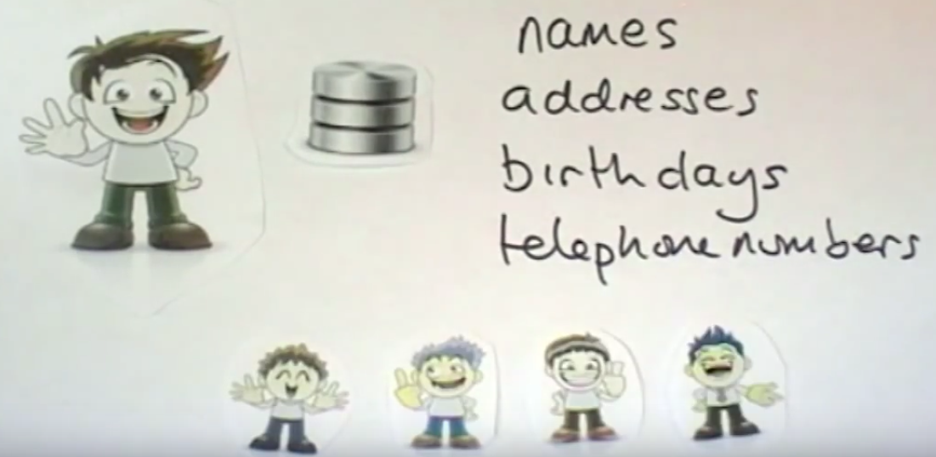
Example
Let’s think about a simple database that Ibrahim uses to store his address book.
This address book contains names, addresses, birthdays, and telephone numbers of his friends and family.

Slide 11
Example
Ibrahim has met his friend Megan, would like to add her to his address book.
He writes down her First Name, Last Name, address, post code, date of birth and her telephone number.

Slide 12
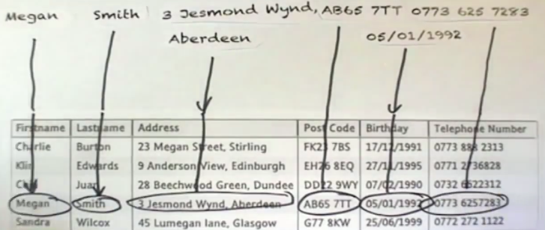
example
The details that Ibrahim writes down are stored in fields in his address book database.

Slide 13
Example
The information about Megan fills a row in his database file.

Slide 14
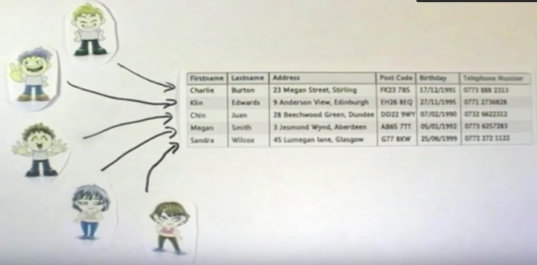
Example
Each row is called a record and each of the rows holds information about a different person in his address book.

Slide 15
Example
Ibrahim can carry out operations on his stored database, he can search it to find a particular person.

Slide 16
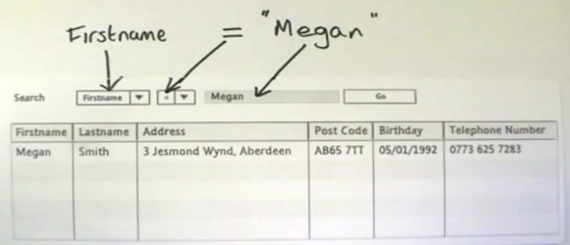
Example
Ibrahim can make the search more accurate by selecting the field he wants . So, he can ask the database to return all the records where the first name = to Megan.

Slide 17
Example
Or Ibrahim could ask the database to show everyone with a birthday in December.

Slide 18
Example

Slide 19
Example
He can sort the database to show the records in a different order.

Slide 20
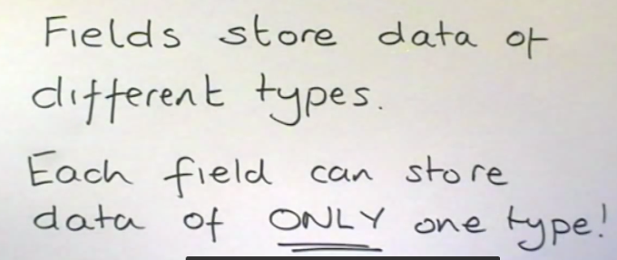
EXAMPLE
Fields can store different types of data.

Slide 21
Example

Slide 22
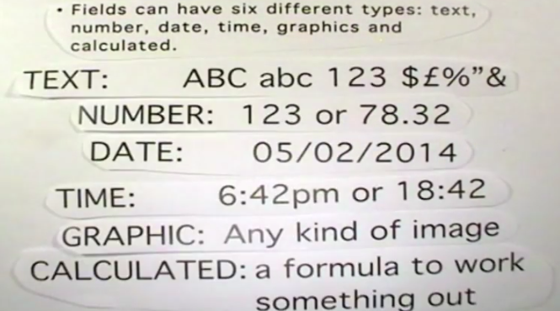
example

Slide 23
Representation or Implementation Data Model-
Relational Database model
Relational database model is the most common type of database model.
Table, record, field, key, and data values are the terms associated with a relational model. The data elements are stored in different tables made up of rows and columns. The data in different tables are related through the use of common data elements.

Slide 24
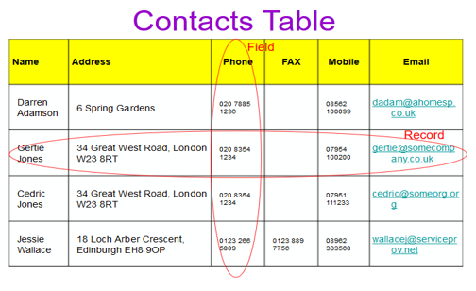
Representation or Implementation Data Model-Relational Database model
Table: group of records is called a Table.
For example a table for student profile can have four columns namely, name, age, address, and
hobby, and have records or rows having data of 30 students.

Slide 25
Representation or Implementation Data Model-Relational Database model
Data Values Data values are the raw data represented in numeric, character, alphanumeric, or alphabetic form. Examples of data values are ‘Ali’, ‘26’ ‘shooting’, “Karachi” etc.
Field or Column Data values or data is stored in a database as fields. For an item or object, a field holds the information of it. For example, individual fields or columns are name, age, address, hobby etc. for an object ‘student profile’.
Record or Row A group of data for related field is called a record. For example, for object ‘student profile’, the related fields are (name, age, address, and hobby). The data about the student #1 (‘Ali’, 26, ‘Karachi’, and ‘Shooting’) is one record.

Slide 26
Representation or Implementation Data Model-Relational Database model
Key A key is an identifier in a table that uniquely identifies a row in a table. The key identifier can be the value of a single column or of multiple columns. A key is generally also referred to as the primary key or a foreign key of the table. The primary key is a unique identifier for the table.

Slide 27
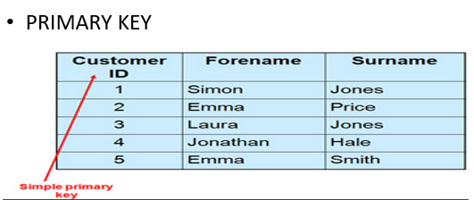
Representation or Implementation Data Model-Relational Database model

Slide 28
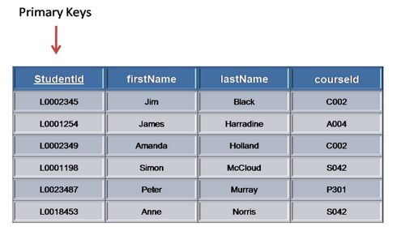
Representation or Implementation Data Model-Relational Database model

Slide 29
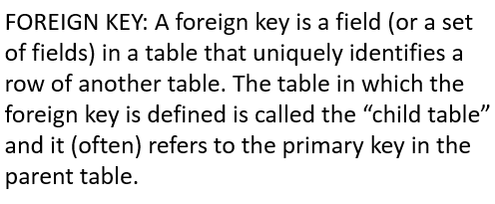
Representation or Implementation Data Model-Relational Database model

Slide 30
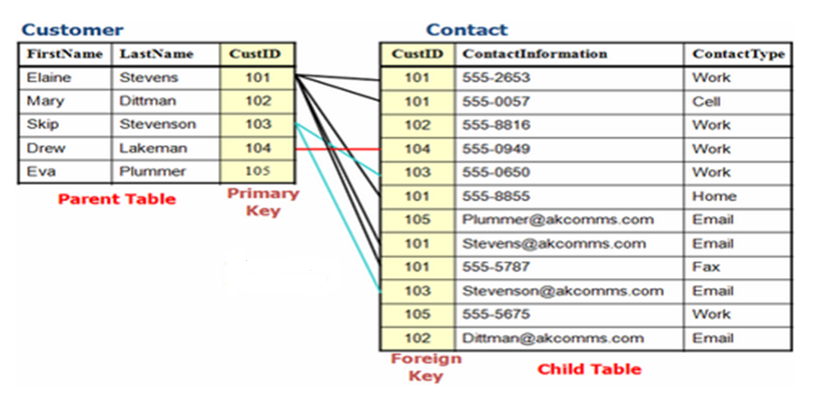
Representation or Implementation Data Model-Relational Database model

Slide 31
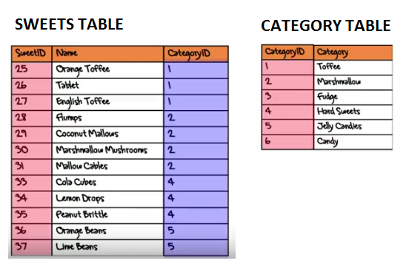
Representation or Implementation Data Model-Relational Database model

Slide 32
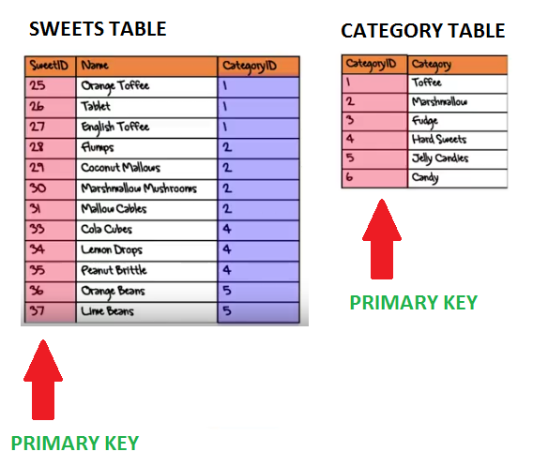
Representation or Implementation Data Model-Relational Database model

Slide 33
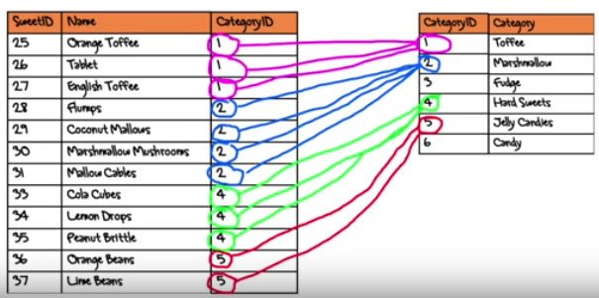
Representation or Implementation Data Model-Relational Database model
Note that the CategoryID in the Sweets Table doesn’t contain unique values.
This special column is used to link the Sweets and Category Tables together.
The CategoryID in the Sweets Table is still a key column but we call this type of key a Foreign Key.

Slide 34
Representation or Implementation Data Model-Relational Database model

Slide 35
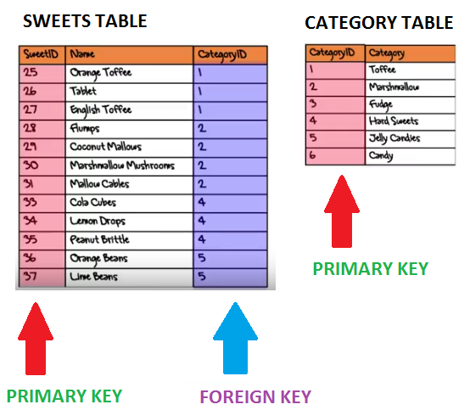
Representation or Implementation Data Model-Relational Database model

Slide 36
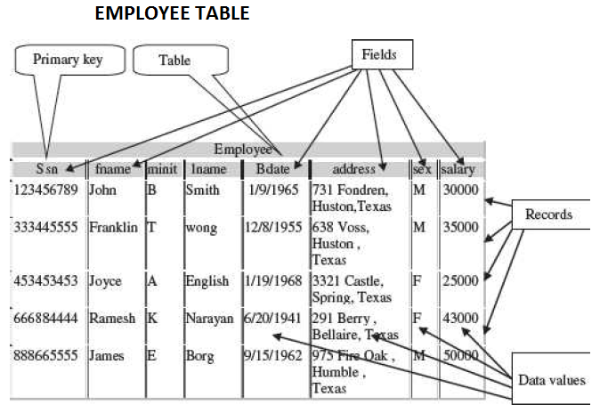
Representation or Implementation Data ModelRelational Database model

Slide 38
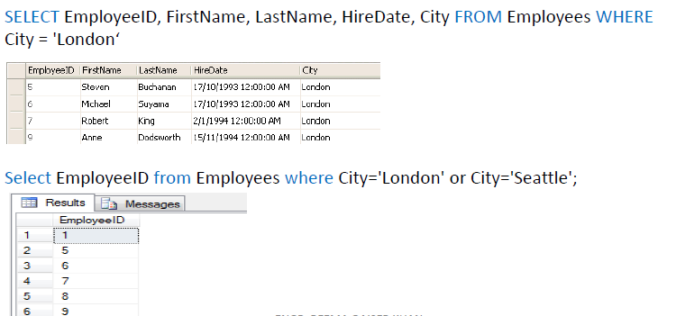

Slide 39
High-level or conceptual database model
The conceptual data model is a description of the data requirements of the user.
It ensures that all the functional and data requirements of the users are specified, conceptually.
The conceptual model is defined usin terms like (1) Entity, (2) Attribute, and (3) Relationship.
The Entity-Relationship model (E-R model) is an example of conceptual data model.

Slide 40
High-level or conceptual database model- entity
ENTITY: It is a real-world object that exists physically or conceptually, such as person, places, things, or events which have relevance to the database. Some specific examples of entities that exist physically are Employee, Student, Lecturer. Some specific examples of entities that exist conceptually are Event, job title, etc..

Slide 41
High-level or conceptual database model- entity

Slide 42
High-level or conceptual database model-entity

Slide 43
High-level or conceptual database model- attribute
An attribute describes some property or characteristics of the entity.
For e.g. student name, student address, and student age are attributes of the entity student_profile.

Slide 44
ENTITY

Slide 45
Entities

Slide 46
High-level or conceptual database model- attribute

Slide 47
High-level or conceptual database model- relationship
An association or link between two entities is represented using a relationship.
Cardinality: The cardinality of a relationship is the number of instances of entity B that can be associated with entity A. The cardinality ratio of a relationship set is any one of the four kinds—(1) One-to-One, (2) One-to-Many, (3) Many-to-One, and (4) Many-to-Many.

Slide 48
High-level or conceptual database model- relationship
In two entity sets A and B, the different cardinality ratio imply the
following:
One-to-One: An entity in A is associated with at most one entity in B and vice versa.
One-to-Many: An entity in A is associated with any number of entities in B, but an entity in B is associated with at most one entity in A.
Many-to-One: An entity in A is associated with at most one entity in B, but an entity in B is associated with any number of entities in A.
Many-to-Many: An entity in A is associated with any number of entities in B and vice versa.

Slide 49
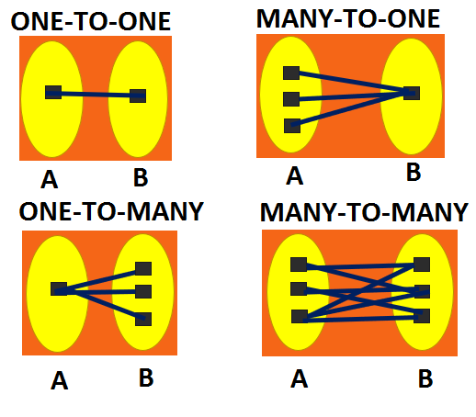
relationship

Slide 50
ONE-TO-ONE
PERSON
PERSON ID | NAME | EMAIL ADDRESS
1 | ALI | ali.we@yahoo.com
2 | Anum | anum12@gmai.com
3 | Saad | s.khan@hotmail.com
PASSPORT DETAILS
PASSPORT ID | PASSPORT NUMBER | PERSON ID
100 | WER12TYG | 1
101 | AB56DJU7 | 2
102 | T2ASD455 | 3

Slide 51
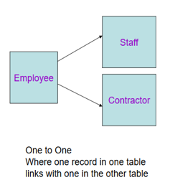
ONE-TO-ONE

Slide 52
ONE-TO-MANY or many-to-one
BOOK
AUTHOR
BOOK ID | BOOK TITLE | ISBN
1 | LET IT SNOW | ISBN302345
2 | THREE CUPS OF TEA | ISBN562439
AUTHOR ID | FULL NAME | BOOK ID
101 | JOHN SMITH | 1
102 | RANA SOHAIL | 1
103 | JOEL MARK | 2
104 | PATRIC JO | 2

Slide 53
One-to-many
CUSTOMER
ORDERS
CUSTOMER ID | CUSTOMER NAME
101 | JOHN JOE
102 | BILL SPARK
ORDERS ID | CUSTOMER ID | ORDERS DATE | AMOUNT
555 | 101 | 12/11/2017 | RS. 5000
556 | 102 | 13/11/2017 | RS. 2500
557 | 101 | 14/11/2017 | RS. 1500

Slide 54
MANY-TO-MANY
ORDERS
ITEMS
ORDERS ID | CUSTOMER ID | ORDERS DATE | AMOUNT
555 | 101 | 12/11/2017 | RS. 5000
556 | 102 | 13/11/2017 | RS. 2500
557 | 101 | 14/11/2017 | RS. 1500
ORDERS ID | ITEMS ID
555 | 201
555 | 202
556 | 202
556 | 203

Slide 55
High-level or conceptual database model- ENTITY RELATIONSHIP MODEL
ER Model is best used for the conceptual design of a database.
ER Model is based on −
Entities and their attributes.
Relationships among entities.

Slide 56
High-level or conceptual database model- ENTITY RELATIONSHIP MODEL

Slide 57
High-level or conceptual database model- ENTITY RELATIONSHIP MODEL

Slide 58
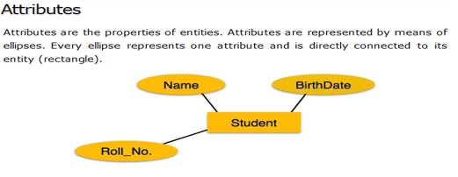
High-level or conceptual database model- ENTITY RELATIONSHIP MODEL

Slide 59
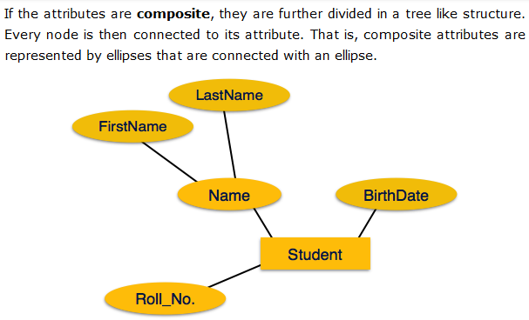
High-level or conceptual database model- ENTITY RELATIONSHIP MODEL

Slide 60
High-level or conceptual database model- ENTITY RELATIONSHIP MODEL

Slide 61
High-level or conceptual database model- ENTITY RELATIONSHIP MODEL

Slide 62
Representation or Implementation Data Model-HEIRARCHICAL DATABASE MODEL

Slide 63
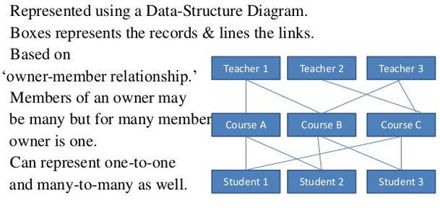
Representation or Implementation Data Model-NETWORK DATABASE MODEL

Slide 64
DATABASE MANAGEMENT SYSTEM
Database management systems (DBMSs) are specially designed software applications that interact with the user, other applications, and the database itself to capture and analyze data.
Well-known DBMSs include MySQL, MariaDB, PostgreSQL, SQLite, Microsoft SQL Server, Oracle, SAP, dBASE, FoxPro, IBM DB2, LibreOffice Base and FileMaker Pro.

Slide 65
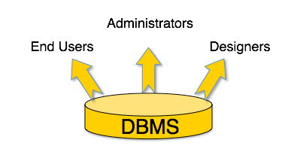
DATABASE MANAGEMENT SYSTEM
A typical DBMS has users with different rights and permissions who use it for different purposes. Some users retrieve data and some back it up. The users of a DBMS can be broadly categorized as follows −

Slide 66
DATABASE MANAGEMENT SYSTEM
Administrators - Administrators maintain the DBMS and are responsible for administrating the database. They are responsible to look after its usage and by whom it should be used. They create access profiles for users and apply limitations to maintain isolation and force security. Administrators also look after DBMS resources like systern license, required tools, and other software and ha rdware related maintenance.
Designers /Application Programmers— Designers are the group Of people who actually work on the designing part of the database. They keep a close watch on what data should be kept and in what format. They identify and design the whole set Of entities, relations, constraints, and views.
End Users — End users are the people who interact with the database system to get information from the database to carry out their business responsibility. They interact with the system through menus or forms. These users can also interact with the system using query languages which requires some expertise for its use. End users include people like executives, managers, clerical staff, bank teller, and so on.

Slide 67
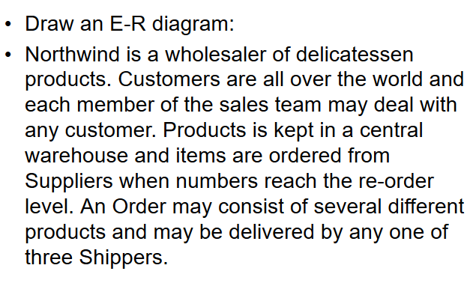
Entity relationship diagram

