Slide 2
A network is a set of technologies – including hardware, software, and media that can be used to connect computers together, enabling them to communicate, exchange information, and share resources in real time.

Slide 3
Local area network LAN: It generally refers to computers that are relatively close in proximity.
The computers in the same home, can be computers in the same office, could be computers in the same building. But when you talk about a lan you're basically talking about computers that are relatively close to each other that are connected and part of the same network they can share printers they can share servers they can share documents and so on between each other, so a local area network is a type of network wherein the computers are in relative close proximity.

Slide 4
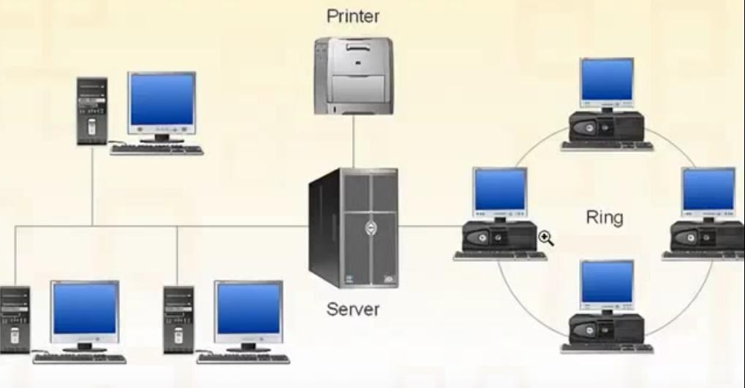

Slide 5
WIDE AREA NETWORK WAN: WAN is two or more LANs connected together, generally across a wide geographical area. For example, a company may have its corporate headquarters and manufacturing plant in one city and its marketing office another. It will be a matter of necessity to connect these individual locations so as to share, exchange and manage data or communication. To achieve this, the organization needs to interconnect the LANs at the different locations.
Internet is a WAN (City to City, Country to Country).

Slide 6
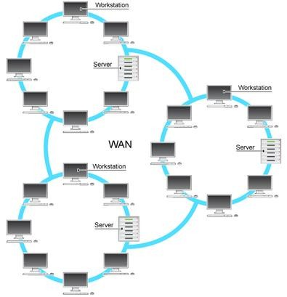

Slide 7
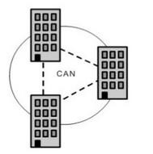
CAMPUS AREA NETWORK CAN: CAN follows the same principal as a local area network, only on a larger and more diversified scale. With CAN, different campus offices and organizations can be linked together. An interconnection of local-area networks within a limited geographical space, such as a school campus or a military base.

Slide 8
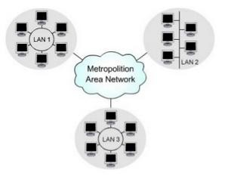
METROPOLITAN AREA NETWORK MAN: Interconnects networks within a city. For example the different branches of banks that communicate with each other situated in the same city.

Slide 9
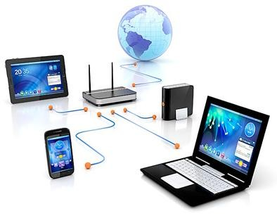
HOME AREA NETWORK HAN: HAN is a network contained
within a user’s home that connects a person’s digital devices, from multiple computers and their peripheral devices, such as printers, to telephones, VCRs, DVDs, televisions, video games, home security systems, “smart” appliances, fax machines, and other digital devices that are wired into the network.
A home network or home area network (HAN) is a type of local area network with the purpose to facilitate communication among digital devices present inside or within the close vicinity of a Home.

Slide 13
A network topology is the arrangement of a network, including its nodes and connecting lines.

Slide 14
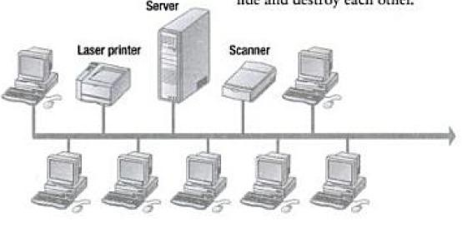
Bus topology is a specific kind of network topology in which all of the various devices in the network are connected to a single cable or line.
The advantage of this topology is that it uses the least amount of cabling.
A disadvantage is that a broken connection can bring down all or part
of the network.

Slide 15
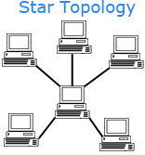
A star topology is a topology for a Local Area Network (LAN) in which all nodes are individually connected to a central connection point, like a hub or a switch. A star takes more cable than e.g. a bus, but the benefit is that if a cable fails, only one node will be brought down.

Slide 16
A ring topology is a network configuration in which device connections create a circular data path. Each networked device is connected to two others, like points on a circle. Together, devices in a ring topology are referred to as a ring network
In a ring network, packets of data travel from one device to the next until they reach their destination. Most ring topologies allow packets to travel only in one direction, called a unidirectional ring network. Others permit data to move in either direction, called bidirectional.
The major disadvantage of a ring topology is that if any individual connection in the ring is broken, the entire network is affected.

Slide 17
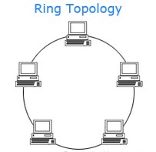

Slide 18
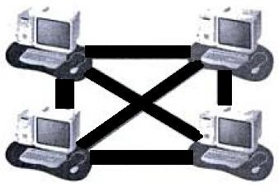
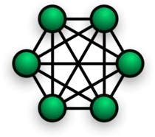
Mesh is the least-used network topology and the most expensive to implement. In a mesh environment. a cable runs from every computer to every Other computer. If you have four computers, you must have six cables—three coming from each computer to the Other computers.
The big advantage to this arrangement is that data Can never fail to be delivered; if one connecti
other ways to route the data to its d
on goes down, there are
estination.
(n*(n-
1))/2

Slide 19
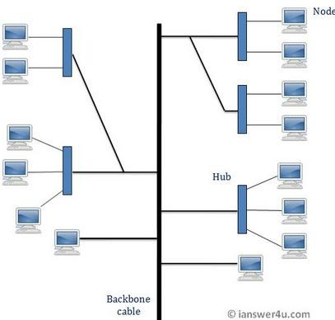
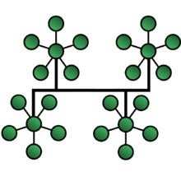
A tree network, or star-bus network, is a hybrid network topology in which star networks are interconnected via bus networks. Tree networks are hierarchical, and each node can have an arbitrary number of child nodes.

Slide 20
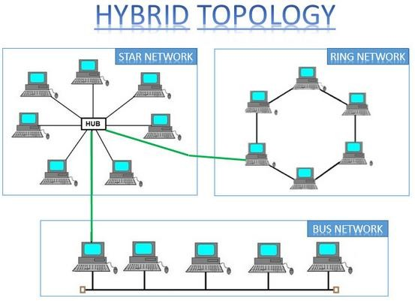
Hybrid topology is a combination of any two or more network topologies.

Slide 21
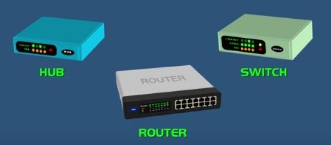
Three types of network hardware:
HUB
SWITCH
ROUTER

Slide 22
The purpose of the HUB is to connect all of your network devices together on an internal network.
It’s a device that has multiple ports that accepts Ethernet connections from network devices.
Hub is considered not to be intelligent because it does not filter any data or has any intelligence as to where the data is supposed to be sent.
The Hub knows when a device is connected to one of its ports and a data packet arrives at one of its ports, it is copied to all the other ports, so all the devices on the Hub sees the data packets.

Slide 23
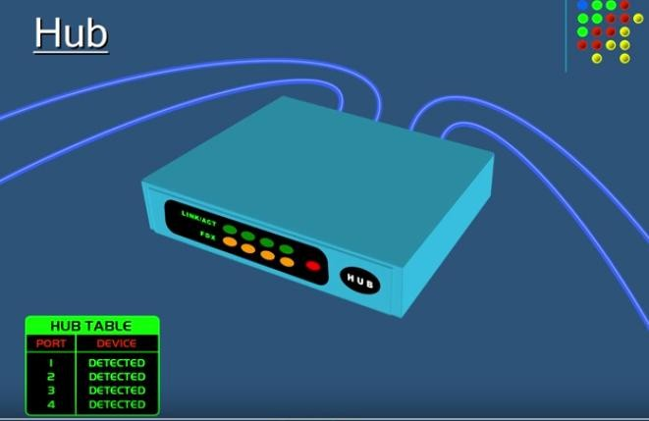

Slide 24
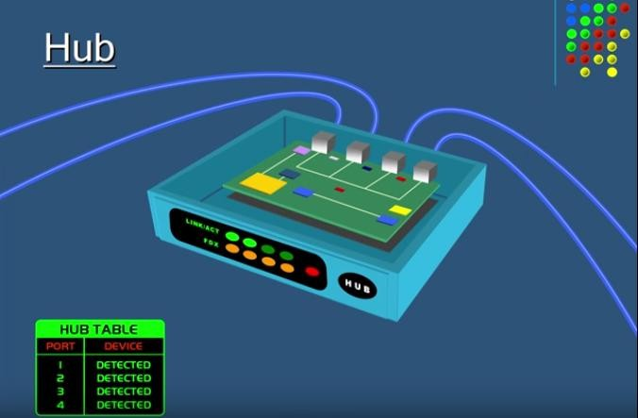

Slide 25
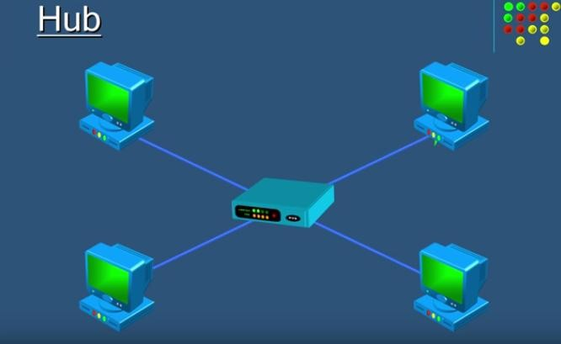

Slide 26
HUB creates security concerns.
HUB also creates unnecessary traffic which wastes bandwidth.

Slide 27
Switch is very similar to a Hub.
Switch is intelligent.
Switch can actually learn the physical addresses of the devices that are connected to it. It stores these physical addresses called MAC addresses in its table. So when a data packet is sent to a switch it’s only directed to the intended destination.

Slide 28
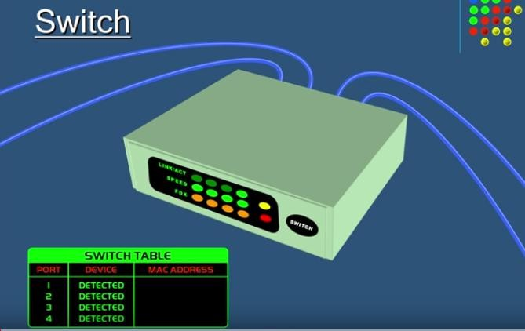

Slide 29
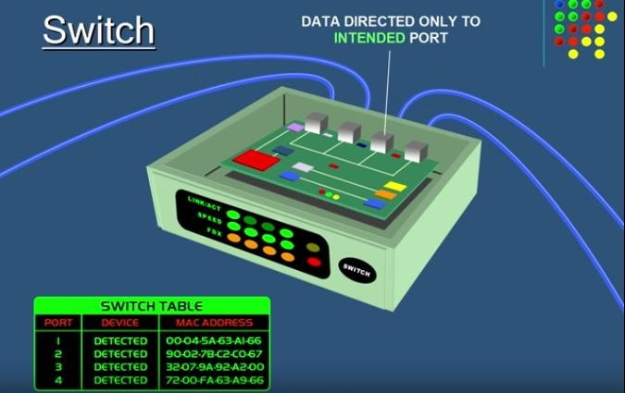

Slide 30
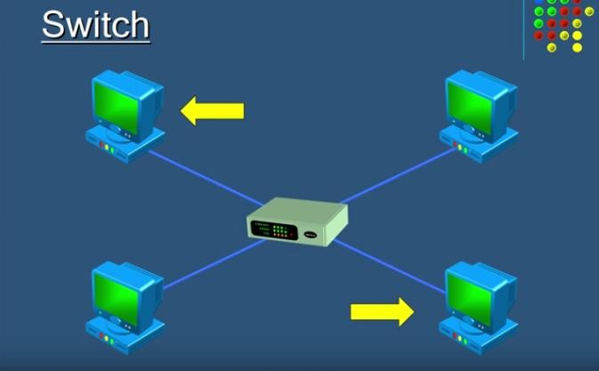

Slide 31
SWITCH

Slide 32
Switches are more preferred than Hub because they reduce any unnecessary traffic on the network.

Slide 34
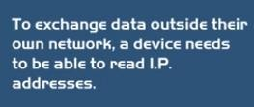
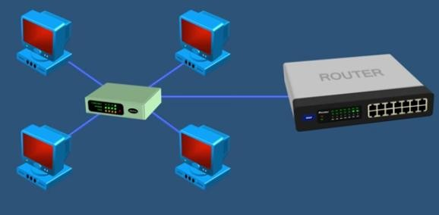
HUBS AND SWITCHES DO NOT READ IP ADDRESSES.

Slide 36
The router inspects the data’s IP address and determines if the packet was meant for it’s own network or if it's meant for another network. If the router determines that the data packet is meant for its own network it receives it but if it's not meant for its own network it sends it off to another network, so a router is essentially the gateway of a network.

Slide 37
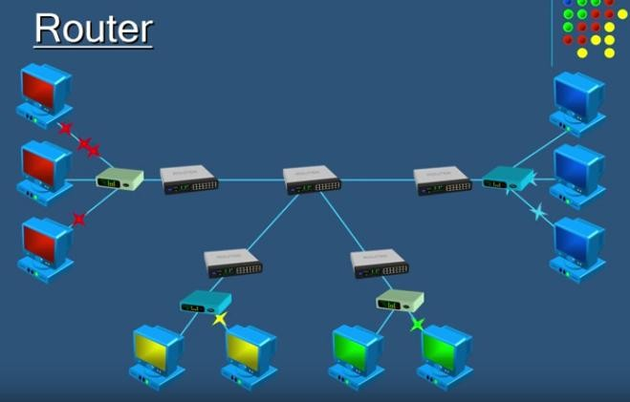

Slide 38
There are two types of Network architectures:
Client/Server Architecture
Peer to peer Architecture

Slide 39
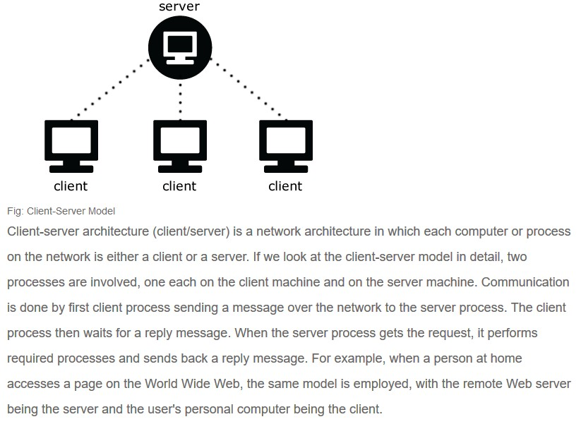

Slide 40
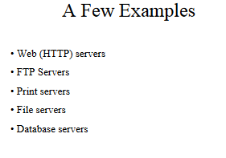

Slide 41
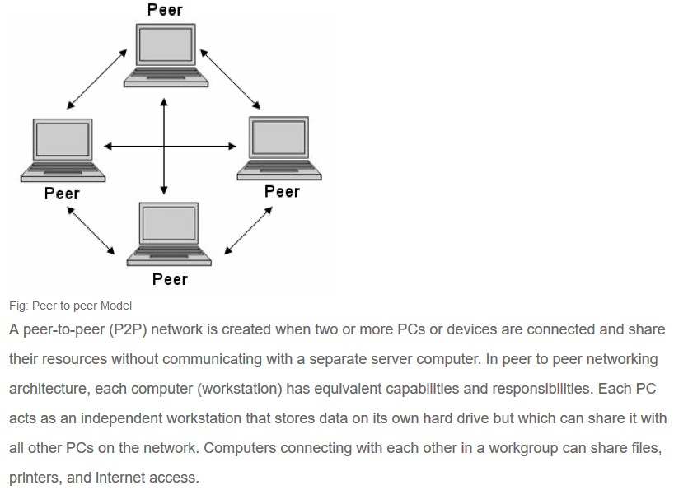

Slide 42
