Slide 1
Computing Fundamentals

Slide 2
CLASSIFICATION
Microcomputer hardware classification
A. Motherboard
B. Input Devices
C. Output Devices
D. Storage Devices
E. Cards
F. Ports & Cords
G. Power Supply

Slide 3
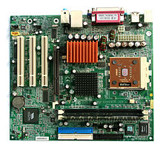
Motherboard
System Board.
Main logic board containing
  CPU Chip
  Memory Chip
  I/O Interface
  Expansion Slots & etc...

Slide 4
Motherboard
The motherboard serves as a single platform to connect all of the parts of a computer together.
It connects the CPU, memory, hard drives, optical drives, video card, sound card, and other ports and expansion cards directly or via cables. It can be considered as the backbone of a computer.

Slide 5
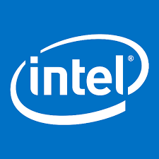






Popular Manufacturers
Following are the popular manufacturers of the motherboard.
  Intel
  ASUS
  AOpen
  ABIT
  Biostar
  Gigabyte
  MSI

Slide 6
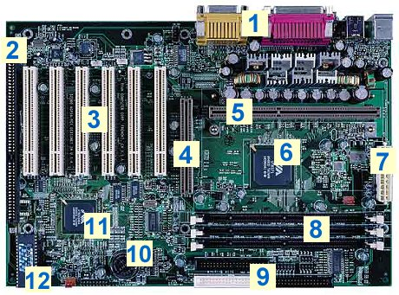
Components of a motherboard
1.Ports
2. ISA Slot
3.PCI Slots
4.AGP Slot
5. Slot
6.Chipset (Northbridge)
7.Power connector
8.Memory sockets
9.I/O connectors
10.Battery
11.Chipset (Southbridge)
12.BIOS chip

Slide 7
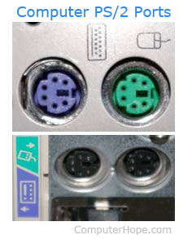
Port
When referring to a physical device, a hardware port or peripheral port is a hole or connection found on the front or back of a computer. Ports allow computers to access external devices such as printers.

Slide 8
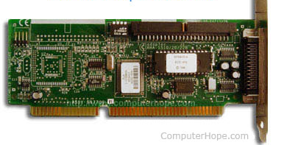
ISA
Short for Industry Standard Architecture.
ISA bus that allowed the computer to automatically detect and setup computer ISA peripherals, such as a modem or sound card. Pnp ISA provides the capability of connecting a device and not having to configure manually.
All modern computers today no longer included the ISA slots and instead are using more PCI, AGP, and other slots

Slide 9
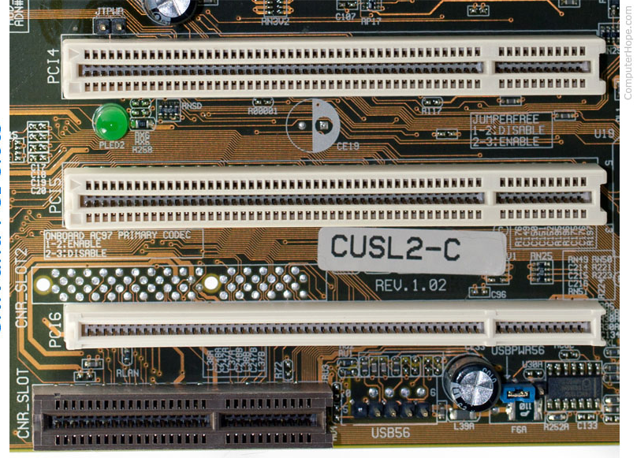
PCI
Short for peripheral component interconnect.
The PCI bus came in both 32-bit and 64-bit versions and is used to attach hardware to a computer.
PCI slots are used to Insert or install Add-on cards, such as LAN cards, Sound cards and TV tuner cards. There are usually from 1 to 6 PCI slots available on the motherboard.

Slide 10
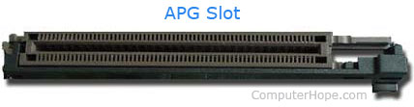
AGP
Short for accelerated graphics port.
AGP is an advanced port designed for video cards and 3D accelerators.
AGP introduces a dedicated point-to-point channel that allows the graphics controller direct access to the system memory.

Slide 11
Cont.
Northbridge: This allows communication between the CPU and the system memory and PCI-E slots. It is a focal Point of Motherboard and It is also called as Memory Controller Hub.
Socket: This is where the CPU will plug in. The orange bracket that is surrounding it is used for high end heat sinks. It helps to support the weight of the heat sink.

Slide 12
Cont.
ATX Power Connector: This is the second of two power connections. This is the main power connection for the motherboard, and comes from the Power Supply.
IDE connectors or PATA connectors : IDE full form is Integrated Device Electronics. it supports IDE devices, such as Hard disks and CD and DVD drives. Most drives today come with SATA connections.
SATA Connections : SATA full form is Serial Advanced Technology Attachment. These are connect with serial ATA devices, such as Hard disk drives and CD or DVD drives.
CMOS battery :This is the motherboard's battery, which is used to power the south bridge and the BIOS to save the setting, data and time.

Slide 13
Input Devices
In computing, an input device is (a piece of computer hardware equipment) used to provide data and control signals to an information processing system

Slide 14

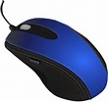
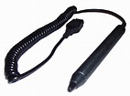
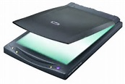
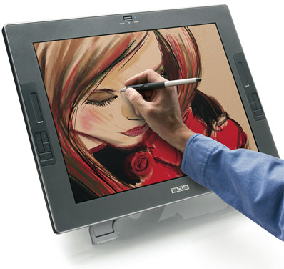

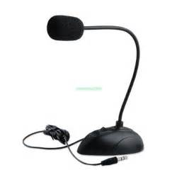
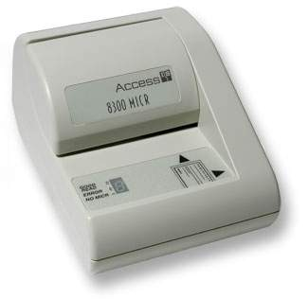
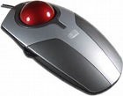
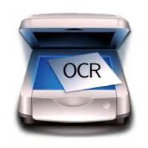
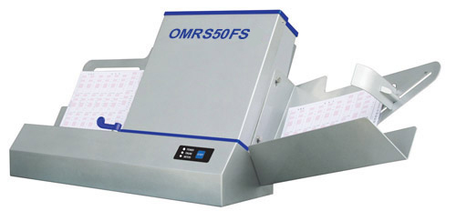
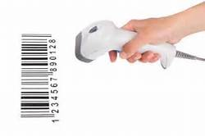
Input Devices
Following are some of the important input devices which are used in a computer..
  Keyboard
  Mouse
  Joy Stick
  Light pen
  Track Ball
  Scanner
  Graphic Tablet
  Microphone
  Magnetic Ink Card Reader(MICR)
  Optical Character Reader(OCR)
  Bar Code Reader
  Optical Mark Reader(OMR)

Slide 15
Output Device
An output device is any device used to send data from a computer to another device or user.

Slide 16
Storage Devices
A storage device is any computing hardware that is used for storing, porting and extracting data

Slide 17
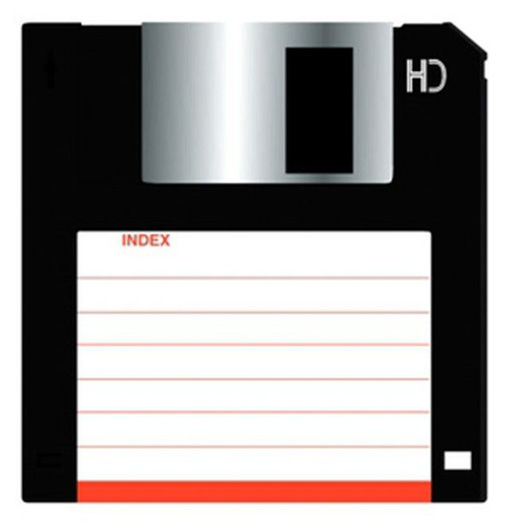
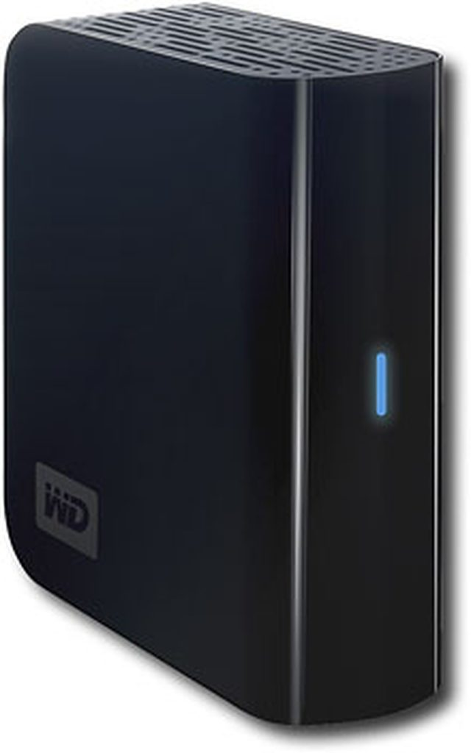
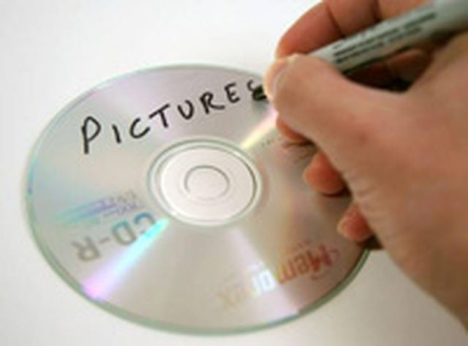
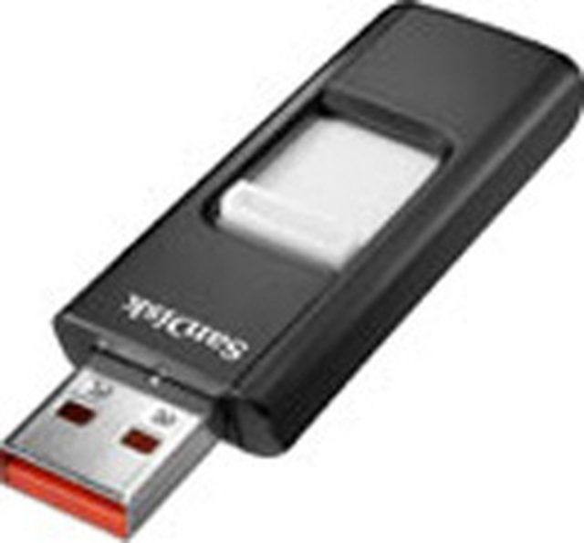
Storage Devices
Following are some of the important storage devices which are used in a computer..
  Floppy Disks
  Hard Disk Drives
  Flash Drives
  CDs and DVDs

Slide 18
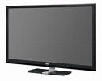
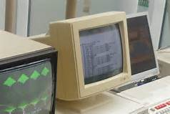
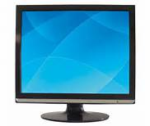
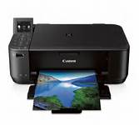
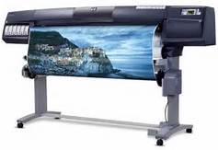
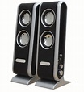

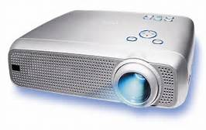
Output Devices
Following are some of the important input devices which are used in a computer..
  Monitor (LED, LCD, CRT etc)
  Printers (all types)
  Plotters
  Projector
  Speaker(s)
  Head Phone

Slide 19
Card
In computing, the expansion card, expansion board, adapter card or accessory card, is a printed circuit board that can be inserted into an electrical connector, or expansion slot on a computer motherboard

Slide 20
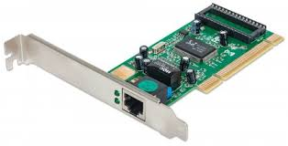
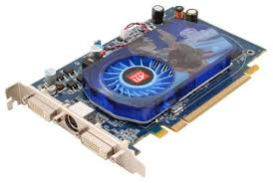
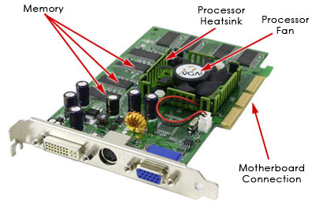
Cards
Following are some of the important storage devices which are used in a computer..
  Network Card
  Video Card
  Graphic Card

Slide 21
Click to watch inside of your computer
https://video.search.yahoo.com/yhs/search?fr=yhs-iba-1&hsimp=yhs-1&hspart=iba&p=how+computer+mouse+works+video+animated#id=3&vid=522a7c2a18a0c7d2e54877b4497d51f7&action=click

Slide 22
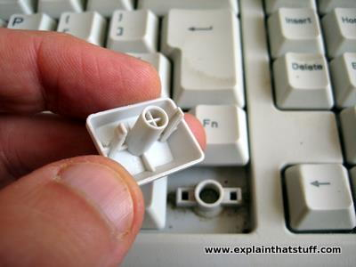
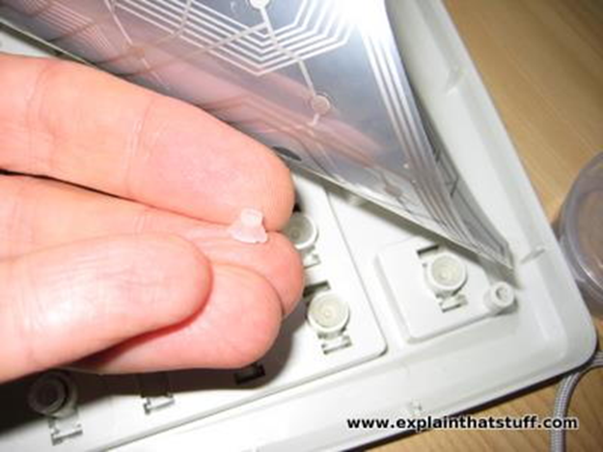
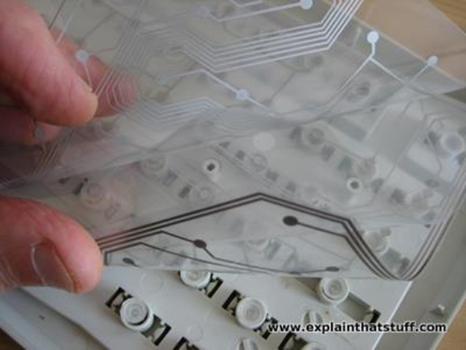
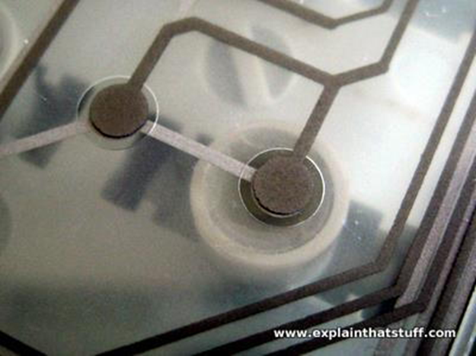
Keyboard

Slide 23
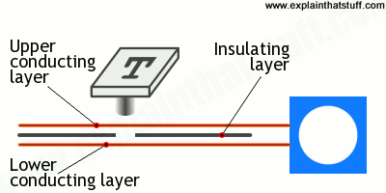
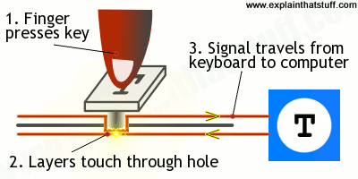
Cont:

