Slide 2
The United Nations’ 17 Sustainable Development Goals (SDGs) aim to achieve decent lives for all on a healthy planet by 2030. As things stand, most of them are likely to be missed. This is partly because they fail to address human population growth. Positive, empowering population solutions are key to meeting the SDGs. Read on to learn about the links between population and each of the 17 goals.

Slide 3
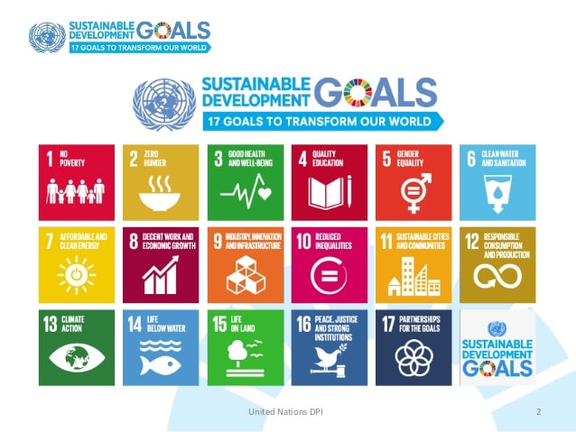

Slide 29
https://www.sdgpakistan.pk/

