Slide 4
Part 1: Islamophobia is a prejudice, aversion, hostility, or hatred towards Muslims.
Hate crime
Street harassment
Verbal abuse
Online abuse

Slide 5
Part 2: It includes any discrimination that excludes or limits Muslims’ equal exercise of fundamental freedoms in the political, economic, social, cultural or any other field of public life.
Workplace discrimination
Barriers to political involvement
Policies that unfairly target Muslims (eg, stop and search/ PREVENT)
Obstructing religious rights (eg, the right to religious dress)
Shutting down Muslim voices from legitimate debates

Slide 6
Hate Crime
Street harassment
Vandalism
Assault
Discrimination
Workplace
Access to opportunities
Structural
Public policies

Slide 7
Social Media
Between March 2016-March 2017, 143,920 Tweets were sent from the UK that are considered to be derogatory and anti-Islamic – this amounts to 393 a day.
Hate Crime
Every month between 2017-18 there was an average of 4,630 racially/religiously aggravated offences recorded by the Home Office.
Greater Manchester Police revealed a five-fold increase in Islamophobic hate crimes following the Manchester Arena bombing in May 2017, with 224 anti-Muslim hate crimes reported in the month following the attack compared to 37 during the same period the year before.
Of the reports to MEND’s IRU:
75% of our hate crime reports come from women. This number rises to 80% when just looking at physical assaults.
Perpetrators are overwhelmingly white males between the ages of 30-55.
Education
Following the Manchester Arena attack in 2017, Childline provided 300 sessions because of religiously-motivated bullying.

Slide 8
Employment
CVs with Muslim names are three times more likely to get rejected compared to English-sounding names despite having identical skills and experiences.
One in eight Pakistani women have been illegally asked at interview about their future plans regarding marriage and family – compared to one in thirty for White women.
Media
Studies have demonstrated that there are 21 negative references to Muslims within British media output for every single neutral or positive reference.
Counter-terror
Muslims being disproportionately stopped at airports for reasons as spurious as reading books or returning from pilgrimage.
Muslim children being erroneously flagged by PREVENT and CHANNEL for reasons ranging from wrongly-interpreted t-shirts to campaigning for human rights issues.

Slide 11
Are there people and groups responsible for Islamophobia? Why are they spreading hatred against Muslims and Islam? What biases have they developed against Islam?
A cursory look at the statements issued by different groups and individuals against Islam and Muslims on a regular basis suggest that the following are the main sources from where anti-Islam propaganda is spreading in the world:
Right wing Christian Evangelical groups. They preach hatred against Islam in their places of worship and declare Islam as evil and Muslims as pagans out to destroy western civilization.
Jewish supremacists and their supporters. they promote hatred against Arabs and Muslims and claim that Muslims are anti-Jewish and anti-Semitic.
White supremacists. They regard Muslims as part of dark races and even those who are born in Caucasian region cannot claim to be white. They believe that God is on the side of White race.
Hindutva supremacists. They believe that their God is only there for them and others are untouchables and consider Muslims in India invaders who must be converted back to Hinduism.
ISIS and Violent Muslim groups. They believe that God has given them license to kill innocents and they use the miseries of Muslim people to hurt innocents.
Buddhist supremacists. They believe that they can claim peace while killing others and want to cleanse Myanmar of Muslim presence.
Democratic and Republican demagogues. They serve multinational corporations and the interests of Israel to earn their livelihood. They have least regard to human rights of those who are not like them.
A right wing and multinational corporation-controlled media that loves to see the blood of innocent spill in the streets so that through its reporting and divisive reporting it can get more advertisement and ratings.
A liberal left that view Islam as a bane of human civilization.

Slide 12
Who is funding the hate group to produce Islam phobic material?
How does the Media promote Islamophobia?
How social media is used by Hate group?

Slide 14
Muslims remain underrepresented in key areas of public life:
Politics
Broadcasting
Journalism

Slide 15
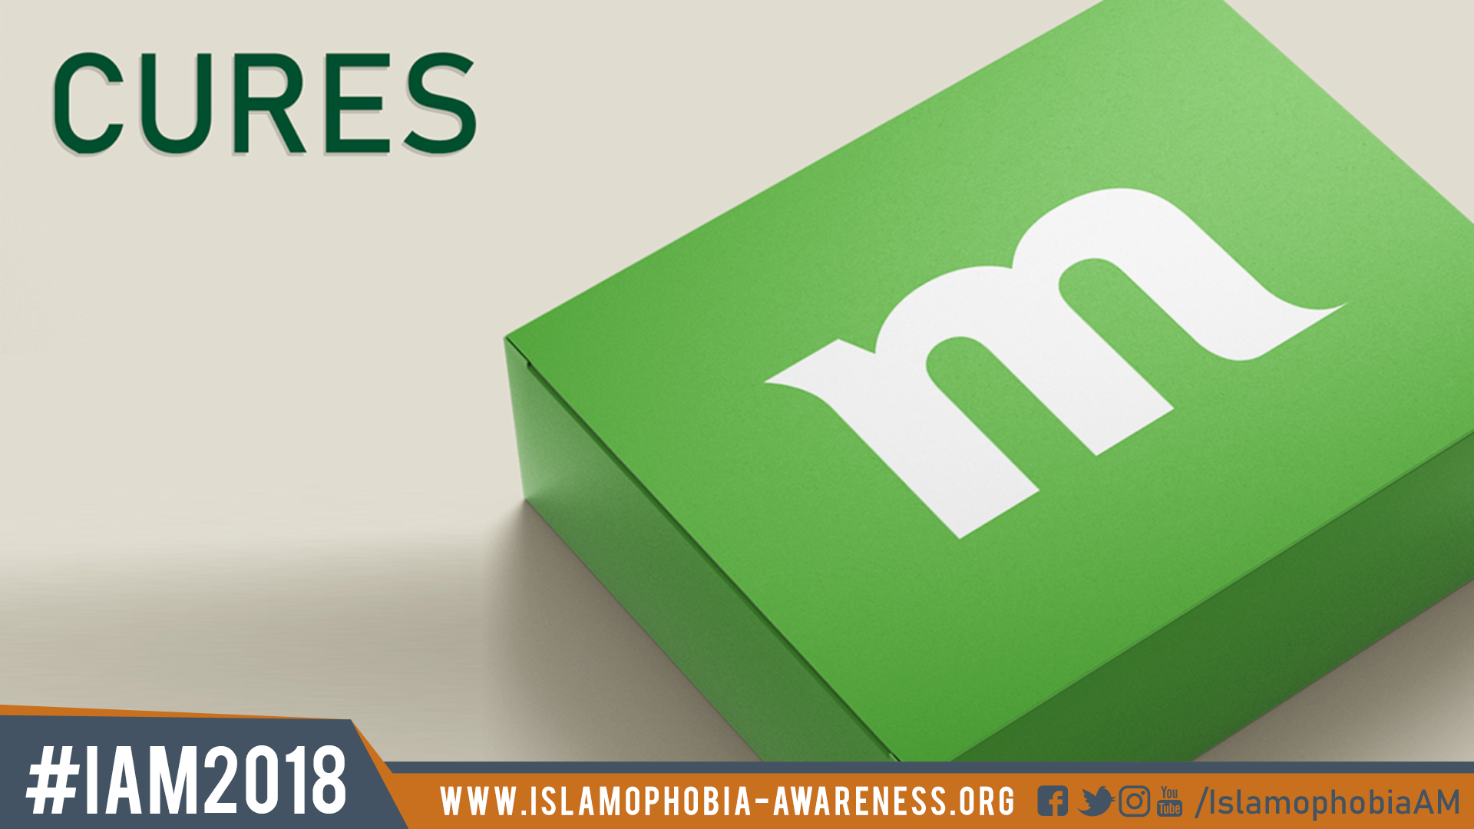
LEGISLATIVE CHANGES
MUSLIM COMMUNITY EMPOWERMENT
WIDER COMMUNITY ENGAGEMENT
GOVERNMENT INITIATIVES

Slide 16
Islamophobia Awareness Month
National campaign working with: Police and Crime Commissioners (PCC), local councils, journalists and local media outlets, councillors and local MPs, mosques, universities, schools, community organisations, and others.
Highlighting Muslim contributions to the UK
Raising awareness about Islamophobia

Slide 17
Rising tide of Islamophobia Causes:
• War on terror after 9/11 incident • Increasing Muslim population a nightmare for White supremacist • Using populist approach to target Islam in west • Immigration of Muslims to western countries • Inappropriate role of International organizations towards Muslims • Polarization of Muslim communities • Biased role of western media • Ubiquitous stereotyping • Illiteracy prevalent in the Muslim World

Slide 18
Impacts of Islamophobia
• Misconception would rise against Islam • Hatred among Muslim and western societies • Alienation of Muslims • Rise of militancy • Impacts on socio-economic life

Slide 19
Steps to Cope Islamophobia
• Injecting true Islamic teachings • Constructive role of Muslim scholars • Non imposing of one’s culture/religion • Zero tolerance for Non State Actors • Muslims communities should unite and unanimously deal Islamophophia • Effective role of OIC • Investing in science and technology sector • Positive role of Media • Promoting education

