Slide 1

WELCOME

Slide 2
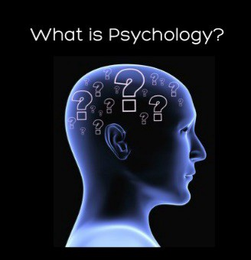

Slide 3
True or False
Does Psychology help you read others mind?
Is Psychology just a common sense?
Studying more about psychology will make you mad.
People who have psychological disorders are more prone to violence.
People use only 10% of their brain.
It will help you in hypnotizing.
False

Slide 4
Questions answered by Psychology
How do we remember, think & reason?
How do drugs alter brain functioning?
What makes us fall in love?
How does learning influence behavior?
What are causes of aggression? How can it be controlled?
How do our genes effect our abilities, personality & behavior?
Which child rearing methods psychologically healthy adults?
To what extent our actions are controlled by unconscious factors?
Can stress kill? What are the effective ways of coping with stress?

Slide 5
Course Outline
Class Norms
Assessment

Slide 6
Books
Essential Readings
1. Hilgard (2003) Introduction to Psychology 14 th Edition Australia, Thomson Publishers
2. Myers, D. (2004) Psychology (8 th Ed). New York: Worth
Recommended Readings
1. Lahey, B. (2004). Psychology: A n Introduction. (8th Ed).Boston: McGraw-Hill
2. Weiten, W. (2005) Psychology: Themes &amp; Variation (6 th Ed), Belmont, CA: Wadsworth/Thomson Learning.

Slide 7
PSYCHOLOGY
DEFINITION:
Psychology is the scientific study of mind and behaviour. The word “psychology” comes from the Greek words “psyche,” meaning life, and “logos,” meaning explanation.
Answers WHO (we are), WHAT and WHY we behave in a certain ways and what is human capable of doing
It is the scientific study of behavior and mental processes and how they are affected by an organism’s physical state, mental state, and external environment.

Slide 8
Scientific Study in Psychology
Scientific study requires several things:
Theoretical framework
Testable Hypotheses
Empirical evidence
Behavior and mental processes include overt, observable instances but also include subtle kinds of instances, like brain activity.

Slide 9
Humans and many other creatures included in the scientific study of behavior and mental processes
Physical state relates primarily to the organism’s biology - most especially the state of the brain and central nervous system
Mental state does not have to be conscious - can study mental states in many creatures without their conscious awareness - and can be studied in terms of brain activity.

Slide 10
All organisms function in an environment that is constantly presenting them with problems and challenges that must be solved.
Most people think of psychology as the study of differences between people, but it also includes the study of similarities between people.

Slide 11
Psychology & Its Scope
Broad enough to cover every aspect of our lives: memory, social judgments, recognition, obesity, violence, stress, and many more.
It encompasses nature & cause of our every behavior, feelings, motives and thoughts.
Its important role in solving human problems specially in this rapidly changing world.
Behavior is so complex and so personal that its scientific study posses a lot of challenges.

Slide 12
Sub Fields
Clinical Psychology
Counseling
Educational Psychology
Environmental Psychology
Forensic Psychology
Experimental Psychology
Industrial/Organizational Psychology
Social Psychology
Sports Psychology
Health Psychology
Child Psychology
Criminal Psychology
Occupational Psychology
Neuro Psychology

Slide 13
Scientific Thinking
Scientific thinking is the process of reviewing ideas using science, observations, investigational processes, and testing them to gain knowledge. The goal is to make outcomes of knowledge that may be meaningful to science.
Critical thinking - assess claims on the basis of well-supported reasons and evidence - not on emotional or anecdotal reasoning.
Involves asking questions - one of the most important is, “WHY?”
Involves defining terms - must be clear and concrete
Involves examining evidence - “Let me have my opinion!” doesn’t count
Involves analyzing assumptions and biases - scientific thinkers do not take anything as proven fact and work hard to overcome their own biases in thinking

Slide 14
Scientific Thinking
Involves avoiding emotional reasoning - do not let gut feelings replace clear thinking - emotional conviction does not settle arguments
Involves avoiding oversimplification - the obvious answer is often wrong and misleading - do not argue based on own anecdotal evidence
Involves consideration of other interpretations - the best interpretations are supported by the most evidence and explain the most variables
Involves tolerating uncertainty - sometimes evidence is unclear or does not even exist
Involves asking questions that can be tested in this world

Slide 15
What is the difference between these two statements?
I like Apple more than Android
Apple is better than Android

Slide 16
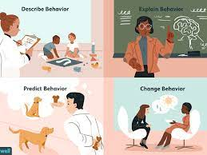
Goals of Psychology
To describe how people & living being behave.
To understand (explain) the causes of each behavior.
To predict how people will behave under certain conditions.
To control or influence behavior through knowledge & control of its causes.

Slide 17
Goals of Psychology
For Examples
  A child throwing tantrums in mall.
  A consumer preferring one brand over another
  An employee being disobedient
  Individual being bossy when given leadership roles

Slide 18
ACTIVITY
Two Truths and a Lie

Slide 19
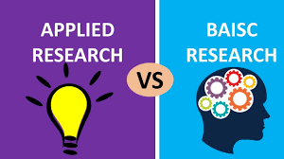
Research in Psychology
Basic Research: research conducted for the purpose of advancing knowledge rather than for practical application (typically three goals: description, explanation, prediction)
Applied Research: research for the purpose of solving practical problems (typically the fourth goal: to control behavior)

Slide 20
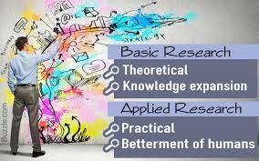
Basic research in psychology typically refers to theory-driven, hypothesis-testing science driven by a quest for fundamental understanding.
Applied psychology is motivated more by a desire to solve practical problems and to move the fruits of our scientific labor into the real world.

Slide 21

Psychologist & Psychiatrist
Psychiatrists are medical doctors, psychologists are not.
Psychiatrists prescribe medication, psychologists can't.
Psychiatrists diagnose illness, manage treatment and provide a range of therapies for complex and serious mental illness.
Psychologists focus on providing psychotherapy (talk therapy) to help patients.

Slide 22
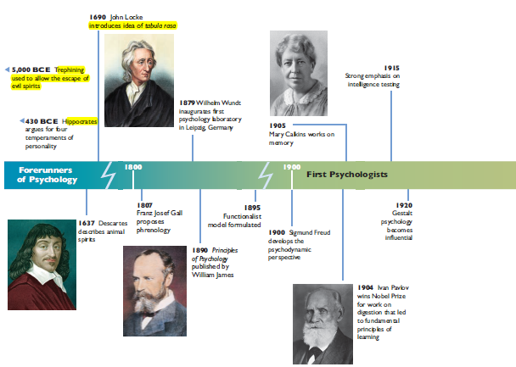
History of Psychology

Slide 23
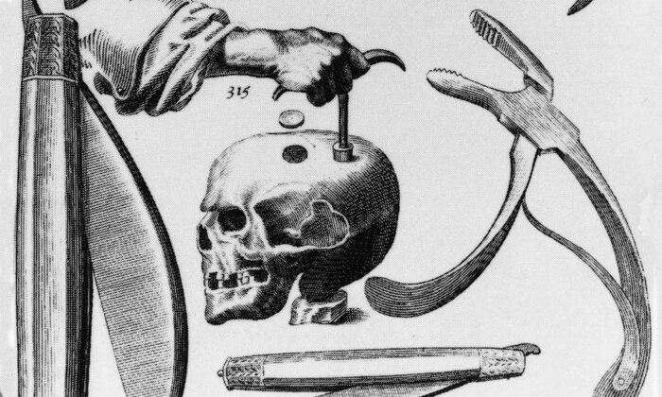
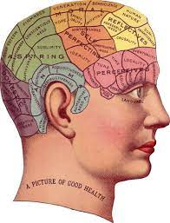
Early roots can be traced back to ancient Greek & Romans
Half a million years ago – psychological problems were viewed as caused by ‘evil spirits’ – operative procedure ‘Trephining’
Descrates – 17th century philosopher explained nerves were hollow tubes through which animal spirits conducted impulses in the same way as water through pipes.
18th century physician – Franz Gall proposes ‘phrenology’ – the shape & bumps on the skull tells about the personality of the person.

Slide 24
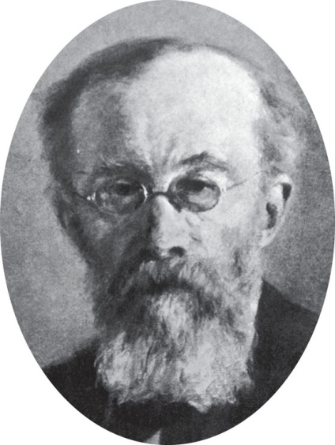
School of thoughts
Structuralism-Wilhelm Wundt
Definition: School of Psychology that stresses the basic units of experience
and combinations in which they occur.
Wilhelm Wundt: Physiologist and Philosopher Founded the first
experimental psychology laboratory in 1879- Leipzig Lab.
Argued that the mind must be studied objectively and
scientifically.
Main concern was with techniques used for uncovering natural laws of the human mind- HE WAS IN SEARCH FOR THE BASIC UNIT OF THOUGHT.

Slide 25
Titchener Student of the Leipzig lab Viewed that human conscious experience could be
understood by breaking it down into components:
Physical sensations (lights & sounds)
Affections of feelings Images (memory and dreams)
Psychology's role is to identify these elements and show how they are combined within the conscious mind.
INTROSPECTION: To study mind people were presented with stimulus and were asked to describe using their own words in as much details as possible what they were experiencing.

Slide 26
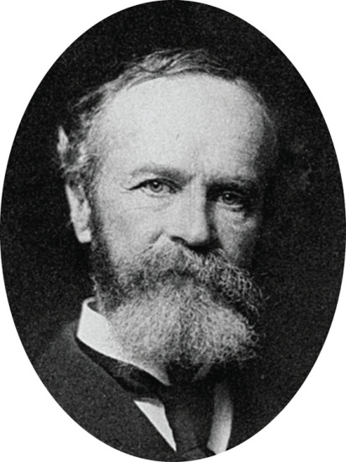
Early Perspective
  FUNCTIONALISM
    Instead of focusing on mind’s components, it focuses on what the mind does & how behavior functions
    In early 1900s – led by American psychologist William James
    What roles behavior plays in allowing people to better adapt to their environment, how behavior allows people to satisfy their needs.
    Suggested that when we repeat something several times, our nervous systems are changed so that each time we open a door, it is easier to open than it was last time.

Slide 27

Early Perspective
GESTALT
  Early 1900s
  It focuses on how perception is organized
  Instead of considering individual parts that make up thinking, gestalt took on concentrating on how people consider individual elements together as units or wholes.
  “the Whole is different from the sum of its parts” means that when considered together, the basic elements that compose our perception of objects produce something greater and more meaningful that those individual elements alone.

Slide 28

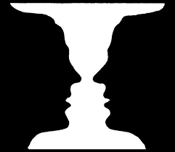

Slide 29
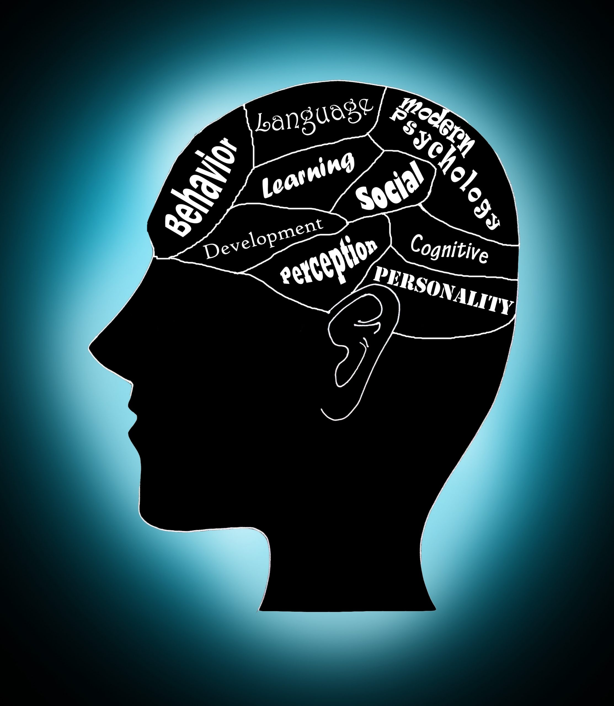
Modern Perspective in Psychology

Slide 30
Behaviour can be viewed from different viewpoints
There are 6 dominant perspectives or ‘schools of thought’
Each will have a different explanation for behaviour
  HELPING BEHAVIOUR: if a person helps a stranger pick up a spilled bag of groceries; why do some people help when others don’t?

Slide 31
Biological Perspective
The biological perspective is a way of looking at psychological issues by studying the physical basis for animal and human behavior.
It is one of the major perspectives in psychology and involves such things as studying the brain, immune system, nervous system, and genetics.
Explain helping behaviour by a natural ‘feel-good’ chemical in the brain

Slide 32
Behavioral Perspective
Believe we learn certain responses through rewards, punishments and observation
Helping behaviour might occur because the person has observed someone being rewarded for helpful behaviour

Slide 33
Cognitive Perspective
Focuses on how people think
How we process information
Remembering something you have learned is a cognitive activity
With this perspective – helping a stranger may be due to how we think about or interpret a situation
We may help the shopper because we think it will make us look good to others
Don’t help – may be because we think it will make us look silly

Slide 34
Psychodynamic
Basis from psychoanalytic (Freud)
Consider how our helping behaviour comes from unconscious drives and conflicts
Helping behaviour comes from an unfulfilled childhood wish to have your mom accept your offer to help

Slide 35
Humanistic Perspective
Consider how healthy people strive to reach their full potential
People may help others if they have met their safety and physiological needs (hunger, thirst, shelter)

Slide 36
Three Levels
Biological
Psychological
Environmental
Cognitive
Psychodynamic
Humanistic
Biological
Behavioral

Slide 37
BIOLOGICAL: Physiological processes underlie behavior – brain processes, hormones, genetic factors
PSYCHOLOGICAL: Analyze the role of thought, memory, planning & problem solving, motivational, emotional, personality processes in the behavior of interest.
ENVIRONMENTAL: Take account of the environment, past & present, personal & cultural that helps shape & stimulates our behavior.

Slide 38
Consumer Stress
BIOLOGICAL
PSYCHOLOGICAL
ENVIRONMENTAL
Stress hormones levels measured at rest & during stress. Measure heart rate & respiration rate. Measurement of muscle tension & sweating
Anxiety (self report personality test) Questionnaire rating of confusion, worry, tension & anxiety Behavioral observations of nervousness during making decisions like nail biting, foot wiggling
Aspects like: unlimited choices, fast changing strategies by organizations, time pressure, noise, heat level . Easy or difficult choices and standards. Expectations of society & people around. Self-expectations

Slide 39
Biological Perspective
It considers biological factors in the study of behavior
  How nerve cells joined together to function biologically
  How the inherited characteristics influence behavior
  How the functioning of body affects hopes, fears
  Which behavior are instinctual
Its contribution is broad in curing mental disorders like amnesia, phobias etc

Slide 40
Behavioral Perspective
John B. Watson (1920s)started behavioral approach.
It focuses on observable behavior that can be measured objectively.
Watson stressed that complete understanding of behavior can be done by studying & modifying environment in which people operate.
Its areas of influence are learning processes, treating disorders, curbing aggression etc

Slide 41
Psychodynamic
It believes that behavior is motivated by inner forces and conflicts over which we have little or no awareness or control e.g. dreams & slips of tongue result of unconscious psychic activity
Sigmund Freud was a Viennese physician who laid its foundation in early 1900s.
Focus was on ‘unconscious determinants of behavior”
It application is widely criticized but applied in treatment of some psychological disorders, and some everyday phenomena of prejudice and aggression.

Slide 42
Humanistic Perspective
It suggests that all individuals naturally strive to grow, develop and be in control of their lives & behavior. Each of us has capacity to seek & reach fulfillment.
Carl Rogers & Maslow leading humanistic psychologists – people will strive to reach their full potential, if given the opportunity.
The emphasis is on ‘free will’ – the ability to make free decisions about one’s own behavior & life.
Free will is opposed to determinism which sees behavior as caused or determined by things beyond a person’s control.

Slide 43
Cognitive Psychology
It is an area that focuses on the science of how people think.
Explores a wide variety of mental processes, including how people think, use language, attend to information, and perceive their environments.
The concept of learning itself is also an example of cognition. This is about the way in which the brain makes connections while remembering what is learned.

