Slide 1
PERSONALITY Development
Marvi Makhdoom

Slide 2
Ever Wonder?
Why not everyone acts the same in similar situations?

Slide 3
Personality
Consistency across situations
Stable/Remains relatively constant & unchanging overtime
Internal
  Lies within us, but our behavior is determined in part by personality
Distinctive
Personality refers to an individual’s unique constellation of consistent behavioral traits.

Slide 4
Personality Traits
A personality trait is a durable disposition to behave in a particular way in a variety of situations.
Adjectives such as: honest, moody, impulsive optimistic etc.

Slide 5
Approaches to Personality
Psychodynamic
Sees personality as an aspect of self which is developed by childhood experiences and unconscious motivations
Biological
Sees personality as a set of characteristics inherited from parents
Humanistic
Sees personality as developed from a set of individual needs and motivation
Social-Cognitive
Influence of environment and thought processes

Slide 6
Psychodynamic
Theories by Sigmund Freud which mainly focus on unconscious mental forces
Freud’s Psychoanalytic Theory
Structure of personality
Level of Awareness
Anxiety & Defense Mechanisms

Slide 7
Psychoanalytic Theory
Attempts to explain:
Personality
Motivation
Psychological disorder by focusing on the influence of early childhood experiences, on unconscious motives and conflicts and coping mechanism of individuals.

Slide 8
Unconscious forces act as determinants of personality
We are not aware of/ Cannot be observed directly
Interpret clues : Slip of tongue, dreams, fantasies
Hidden unconscious provides ‘safe heaven’ for recollection of threatening events (pain, conflict) which shapes our personality

Slide 9
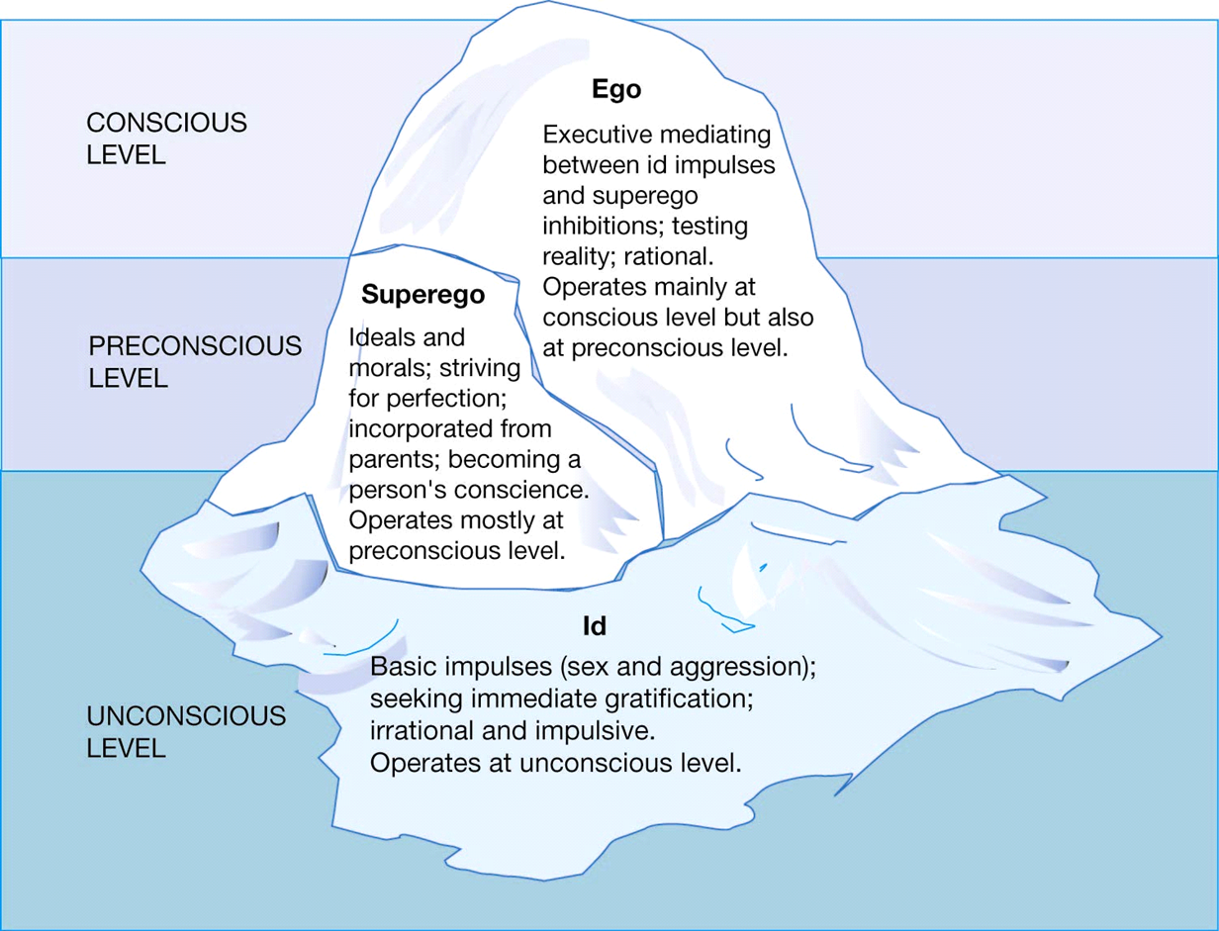
Personality structure

Slide 10
Personality structure
Ego: Reality principle
(May be I can find a compromise)
Superego: Moral Imperatives
(Nice people don’t do it)
ID: Pleasure principle
(I want it right now)

Slide 11
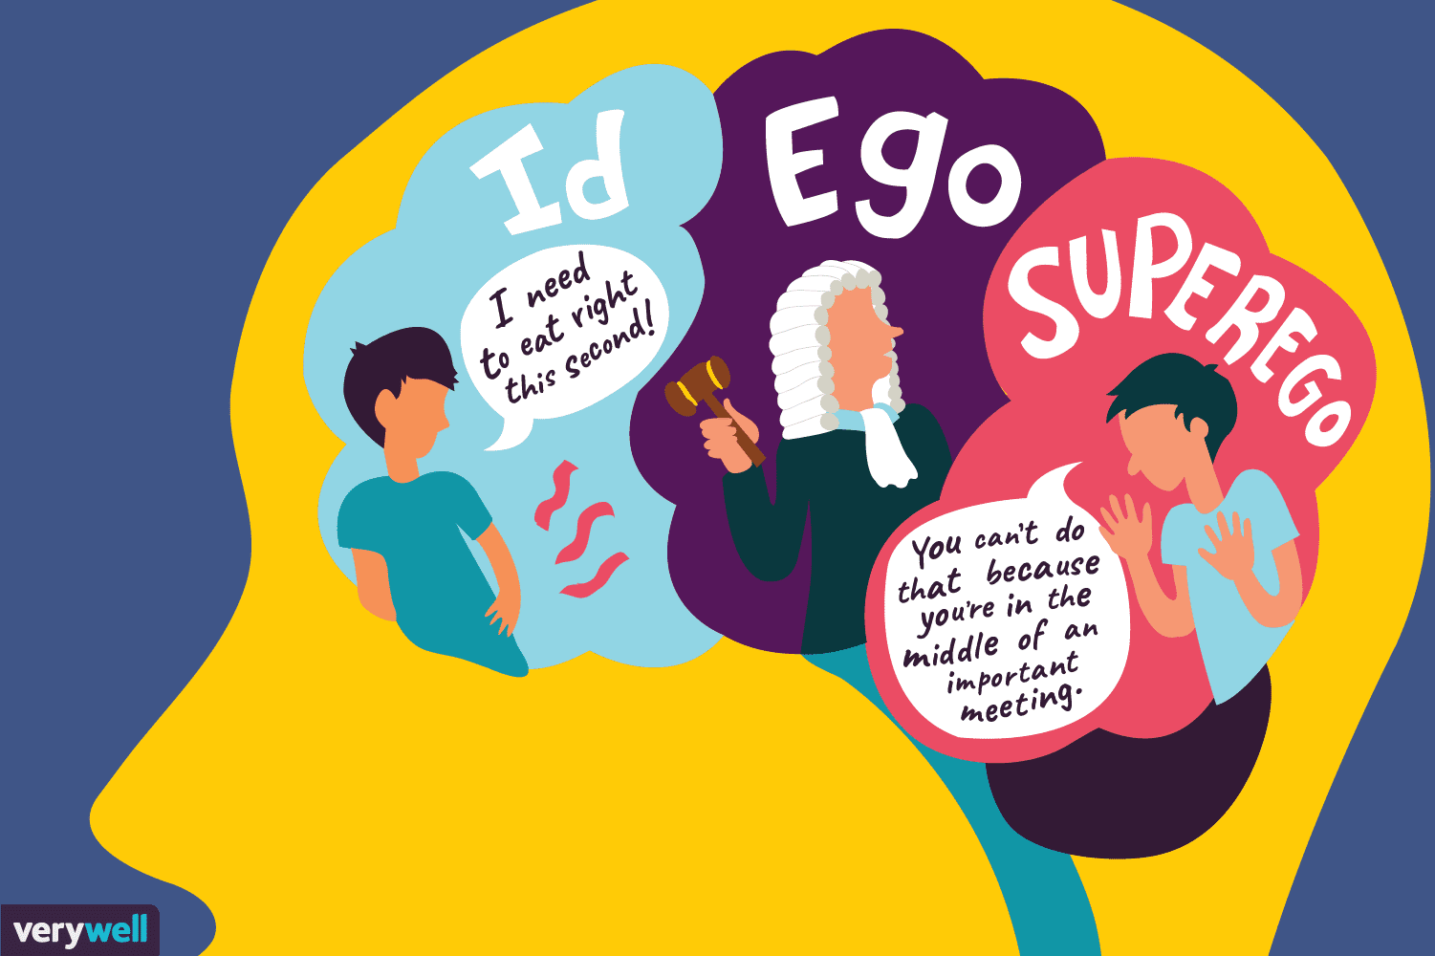

Slide 12
Freud’s stages of development
Oral: Birth to 12-18 months, Oral gratification – sucking, eating, biting
Anal: 18 months to 3 yrs, Expelling & withholding feces, toilet training
Phallic: 3 to 5-6 yrs, Interest in genitals
Latency: 5-6 yrs to adolescence, Sexual concerns largely unimportant (Social contracts)
Genital: Adolescence to adulthood Reemergence of sexual interests, establishment intimate relationships.

Slide 13
Freud’s concept of Fixation
A FIXATION is a persistent focus of the id’s pleasure-seeking energies at an early stage of psychosexual development.
Oral, anal, and phallic fixations occur when an issue or conflict in a psychosexual stage remains unresolved, leaving the individual focused on this stage and unable to move onto the next.
For example, individuals with oral fixations may have problems with drinking, smoking, eating, or nail-biting.

Slide 14
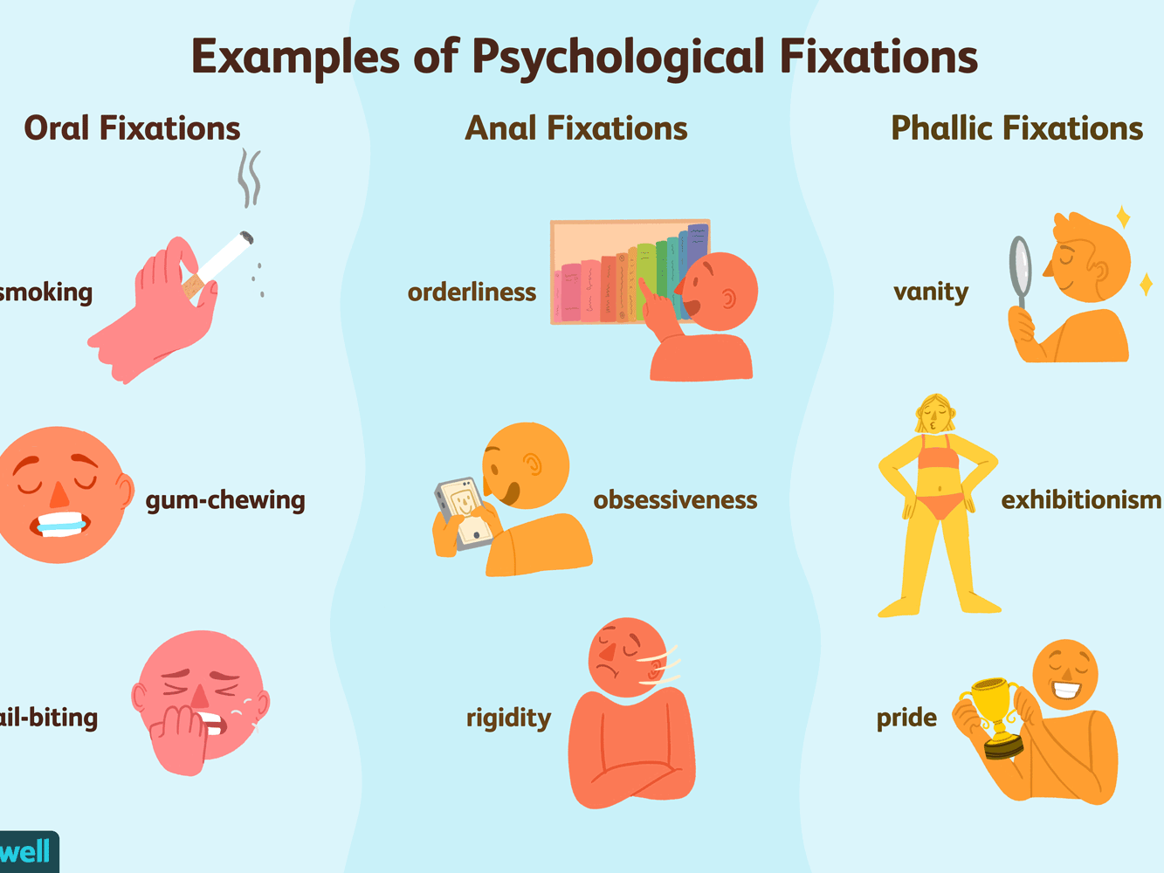
Freud’s concept of Fixation

Slide 15
Defense Mechanisms
Unconscious strategies people use to reduce anxiety by concealing the source of anxiety from themselves & others.
Use these to avoid painful situations but over use of defense mechanisms produce mental disorder what Freud called ‘neurosis’.
Anxiety is defined as an intense, negative emotional experience , it is a danger signal to Ego, as irrational impulses from Id threaten to become uncontrollable…

Slide 16
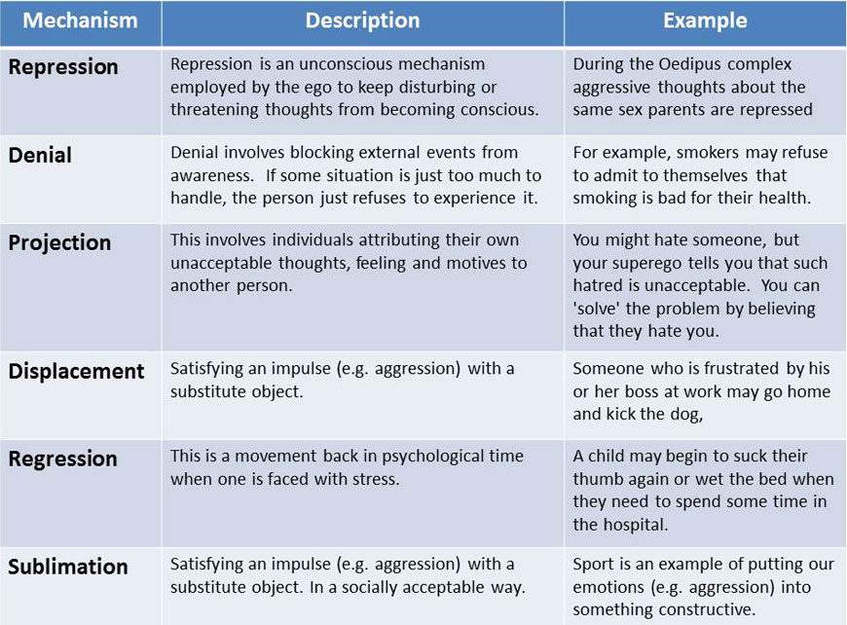

Slide 17
Reaction Formation
Conscious behaviors are adopted to overcompensate for the anxiety a person feels regarding their socially unacceptable unconscious thoughts or emotions.
Example : A man's self-esteem is threatened by the possibility that he is not masculine enough, so he overcompensates by acting aggressive and macho.

Slide 18
Criticism on Freud
Freud theory has significant impact on field of psychology but widely criticized:
  Individual approach
  Unobservable abstract concepts
  Difficult to predict developmental problems in adults
  Culturally influenced

